Slide 2
EightFish
A MVC Framework for Decentralized App
Mike Tang
2023-10

Slide 3
What is EightFish
EightFish is a development framework for decentralized application with powerful performance and easy experience.

Slide 4
Why another framework
There are many blockchain development frameworks, but no good Web3 frameworks. Merely blockchain framework is not enough for the Web3 world.

Slide 5
Substrate is a blockchain framework
Use Substrate, we can build a blockchain network rapidly and easily.
But not enough for Web3.0 App/Dapp.
The daily web app requires:
high performance
cheap storage
powerful query capability
working with existing databases

Slide 6
The Substrate off-chain worker
Story starts from the Substrate OCW (off-chain worker)
What OCW offers.
Ability to submit transactions—either signed or unsigned—to the chain to publish computation results.
A fully-featured HTTP client allowing the worker to access and fetch data from external services.
Access to the local keystore to sign and verify statements or transactions.
An additional, local key-value database shared between all offchain workers.
A secure, local entropy source for random number generation.
Access to the node's precise local time.
The ability to sleep and resume work.
& Forkless upgrade.

Slide 7
The limits of Substrate OCW
The interval stream programming pattern: be called at every block imported, it is hard to master, and should be careful to treat
No execution when in sync state
Can not spawn new task manually and concurrently
Hard to interact with sql databases (only http interface right now)
While the OCW plays its important role in Substrate ecosystem, we need another flexible and powerful solution to extend the ability of Substrate.

Slide 8
How to improve it
How to do？

Slide 9
Step 1: move OCW outside
Use the spin wasm runtime to serve as the off-chain work, listening to the events emitted from the Substrate Runtime.
Runtime
Substrate Node
Spin Worker
OCW
https://www.fermyon.com/spin

Slide 10
Technical requirements
Runtime
Substrate Node
Subxt proxy
Redis
Spin Worker
OCW

Slide 11
Spin worker: an enhanced OCW
Internet
DB
RPC
Spin Worker
Intense Computing
Blocking IO

Slide 12
Step 2: make it more useful
Runtime
Substrate Node
Subxt proxy
Redis
Spin Worker
OCW
SQL DB

Slide 13
Step 3: make it further useful
Runtime
Substrate Node
Subxt proxy
Redis
Spin Worker
OCW
SQL DB
Http Gate

Slide 14
Step 4: make dev more comfortable
Tiny ORM
MVC
Runtime
Substrate Node
Subxt proxy
Redis
Spin Worker
OCW
SQL DB
Http Gate

Slide 15
EightFish Framework Architecture
Tiny ORM
MVC
Runtime
Substrate Node
Subxt proxy
Redis
Spin Worker
OCW
SQL DB
Http Gate

Slide 16
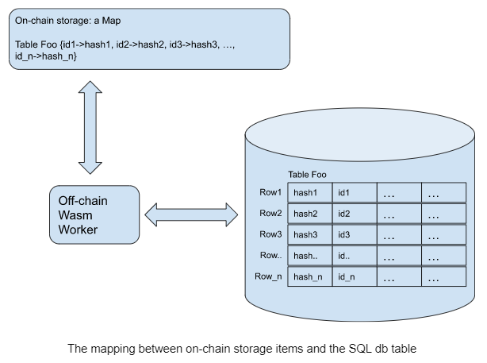
Problem transformation

Slide 17
Standardization of the on-chain index
EightFish actually makes the on-chain index process standardized
Underlying is the theory of the relational database.

Slide 18
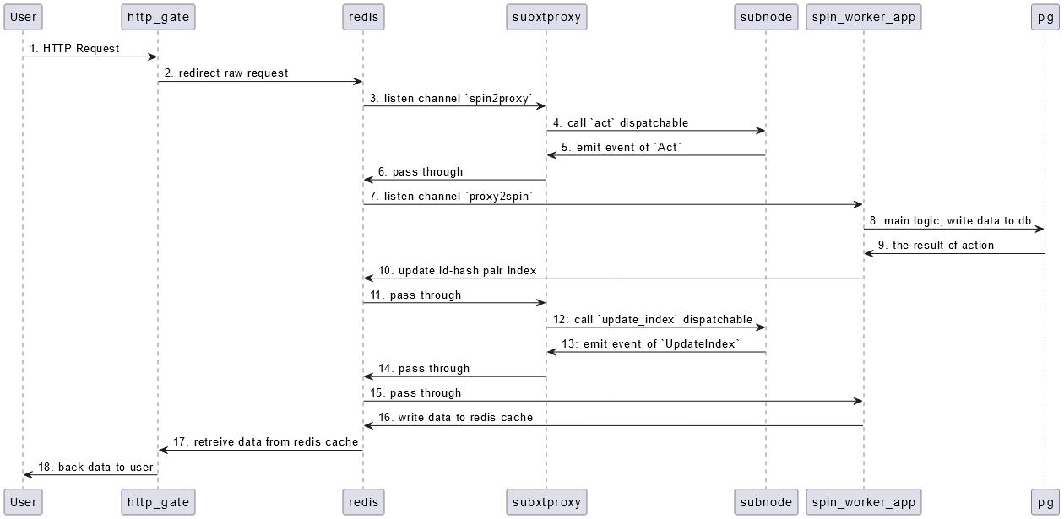
Post process

Slide 19
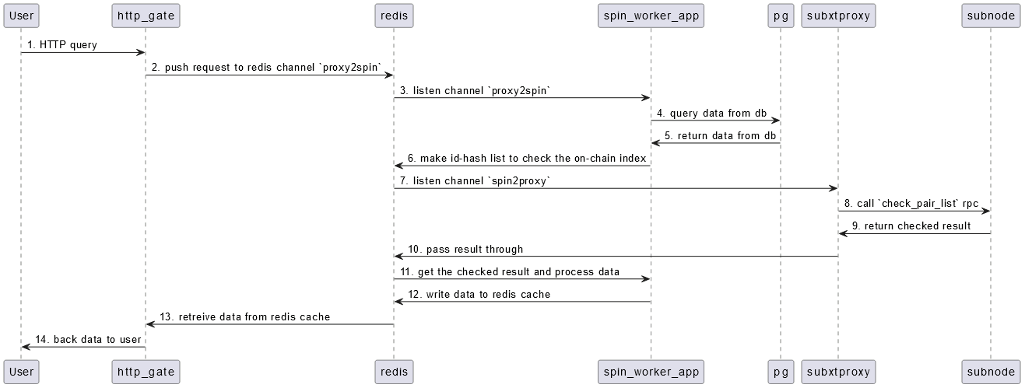
Query process

Slide 20
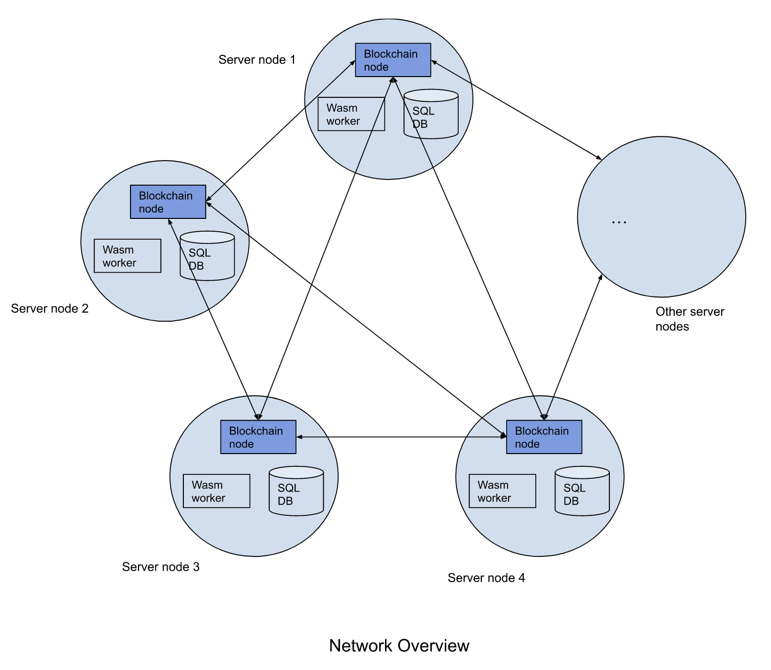
EightFish app network
Network Overview

Slide 21
Explanation
Sync the SQL db tables and rows by through the Substrate node
All components except Substrate node are local, no connections to others EightFish node, so it’s yet a Substrate network
EightFish could leverage all major outstanding databases. e.g. PostgreSQL, MySQL, Sqlite, even mongodb.

Slide 22
The role of Substrate in EightFish
Used to record the incoming raw writing requests, bake them into blocks, like a log system
Used to sync runtime state among all EightFish nodes (Substrate network), further to coordinate the state of the SQL db among all nodes
Used to store the version of wasm code and make the code of spin worker upgrade forklessly
Used to interoperate with other Substrate-based chains by leveraging existing pallets

Slide 23
Some limites of Spin Worker
Should not use local random number, but certain type of deterministic random number from the Substrate node
Should not use local timestamp, but the timestamp from the Substrate node
Can not do the type of operations of SQL JOIN family, because we must check the query result from local SQL db with the on-chain index internally in EightFish, which is unaware by developers. But it supports full-fledged single SQL table query
Yet EightFish is powerful.

Slide 24
So what is EightFish for
Non-assets/xFi application
Fully on-chain application, e.g. fully on-chain game
Fully decentrialized application
General computation/CPU intensive computation

Slide 25
How to use EightFish
Use EightFish MVC framework to write your app service;
Modify a docker compose template to boot up the dependencies of 5 EightFish components as services + your app service
MVC doc:
https://github.com/eightfish-org/eightfish/blob/master/docs/eightfish_mvc_intro.md
ORM doc:
https://github.com/eightfish-org/eightfish/blob/master/eightfish-derive/src/eight_fish_model.rs#L134
docker compose file:
https://github.com/eightfish-org/eightfish/blob/master/docker/docker-compose-1node.yml

Slide 26
How to deploy
Use docker compose to deploy a network, example:
https://github.com/eightfish-org/eightfish/blob/master/docker/docker-compose-4node.yml
Just similar with the standard Substrate chain network.

Slide 27
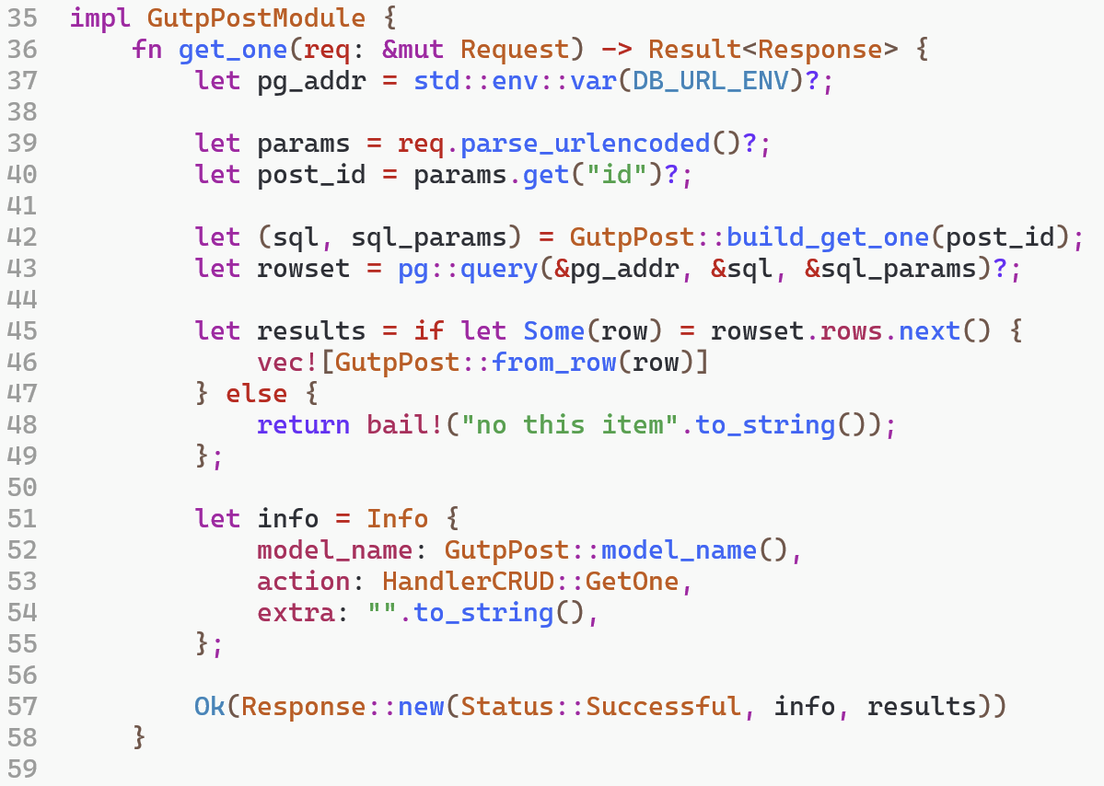
The business code demo
https://github.com/eightfish-org/gutp/blob/master/gutp/src/post.rs#L35

Slide 28
For whom?
EightFish is developed for:
Web developers (Web2)
Substrate developers
Other Web3 developers

Slide 29
One case of EightFish app
GUTP & Meblog, work in progress
https://github.com/eightfish-org/gutp
https://github.com/miketang84/meblog
Could be publicly tested at the beginning of June.

Slide 30
Q&A
Email: daogangtang@gmail.com
Twitter: @daogangtang

