Slide 1
BanyanDB Cloud Native Observability Database
Gao Hongtao Tetrate / Apache

Slide 2
个人简介

Slide 3
CONTENTS
01
03
Observability & TSDB
Glance of BanyanDB
02
04
Data Ingestion
Query Engine

Slide 4
Observability & TSDB

Slide 5
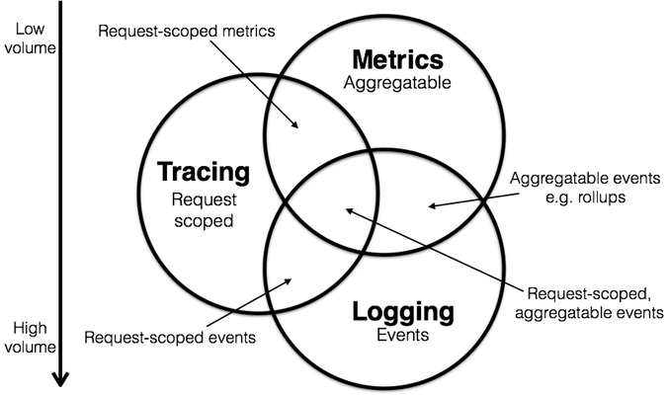
Three Pillars

Slide 6
More Models

Slide 7
Tags & Fields
Timestamp: epoch
metric_name
(label: __name__)
Fields: single-valued or multiple values
LabelSet (Tags)

Slide 8
High Cardinality

Slide 9
Glance of BanyanDB

Slide 10
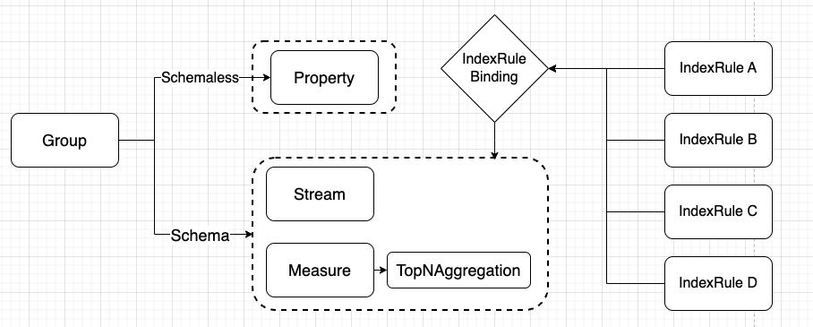
Logical Data Model
Pros:
Reduce High Cardinality
Validation
Querying
Integration
Cons:
Complexity
Overhead
Maintenance

Slide 11
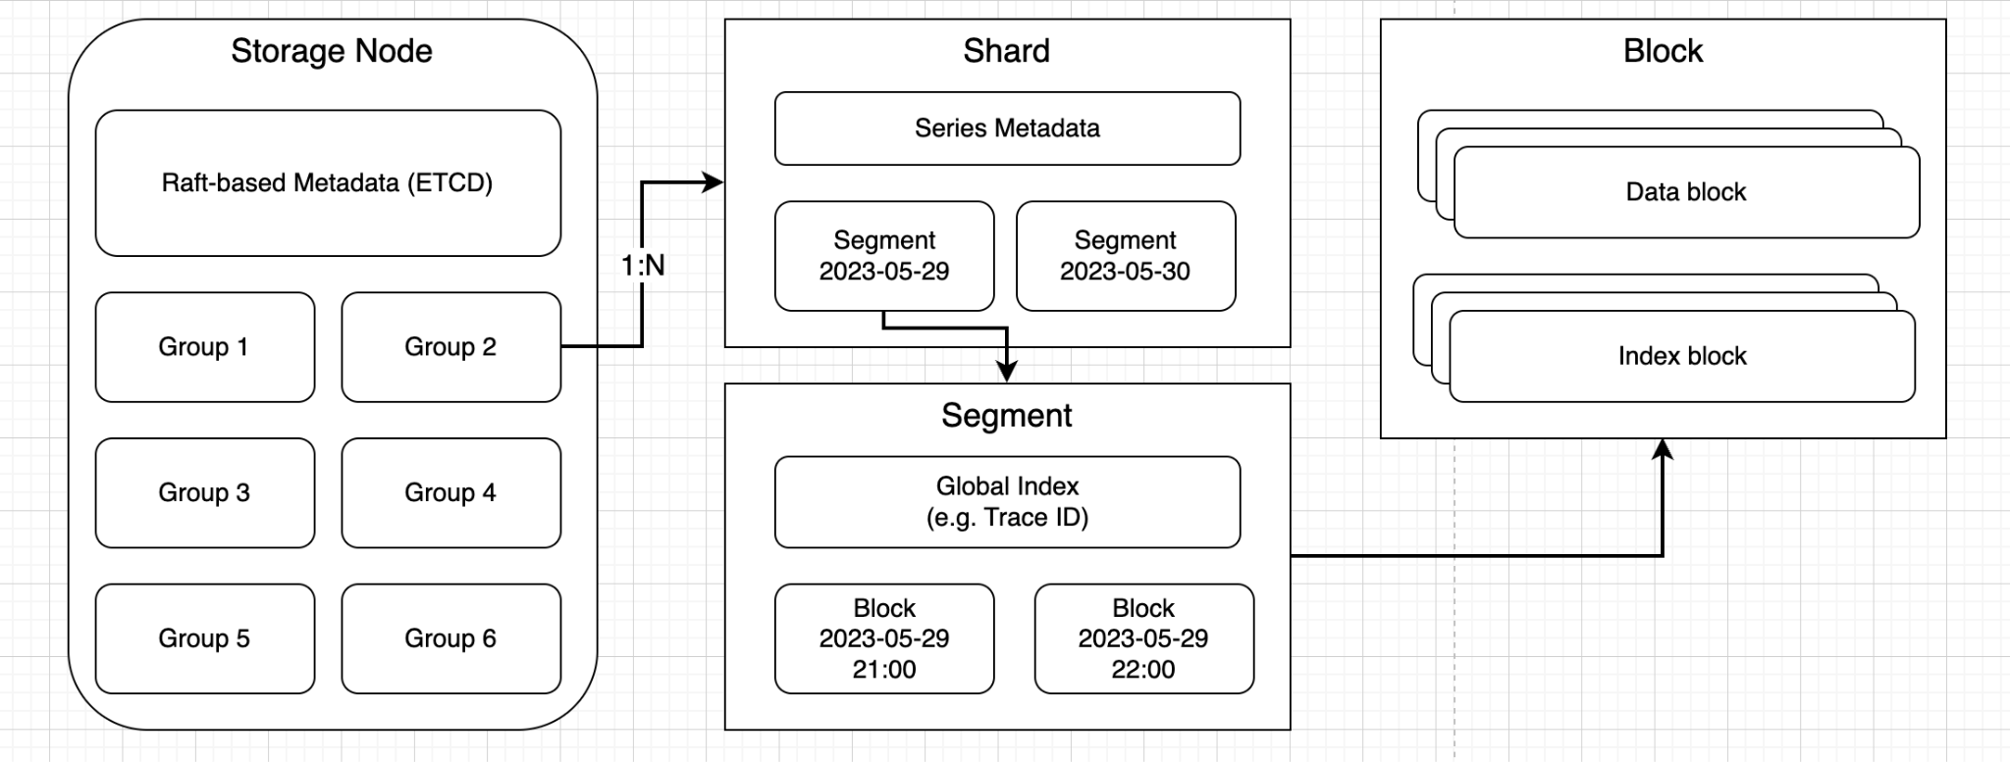
Physical Data Model

Slide 12
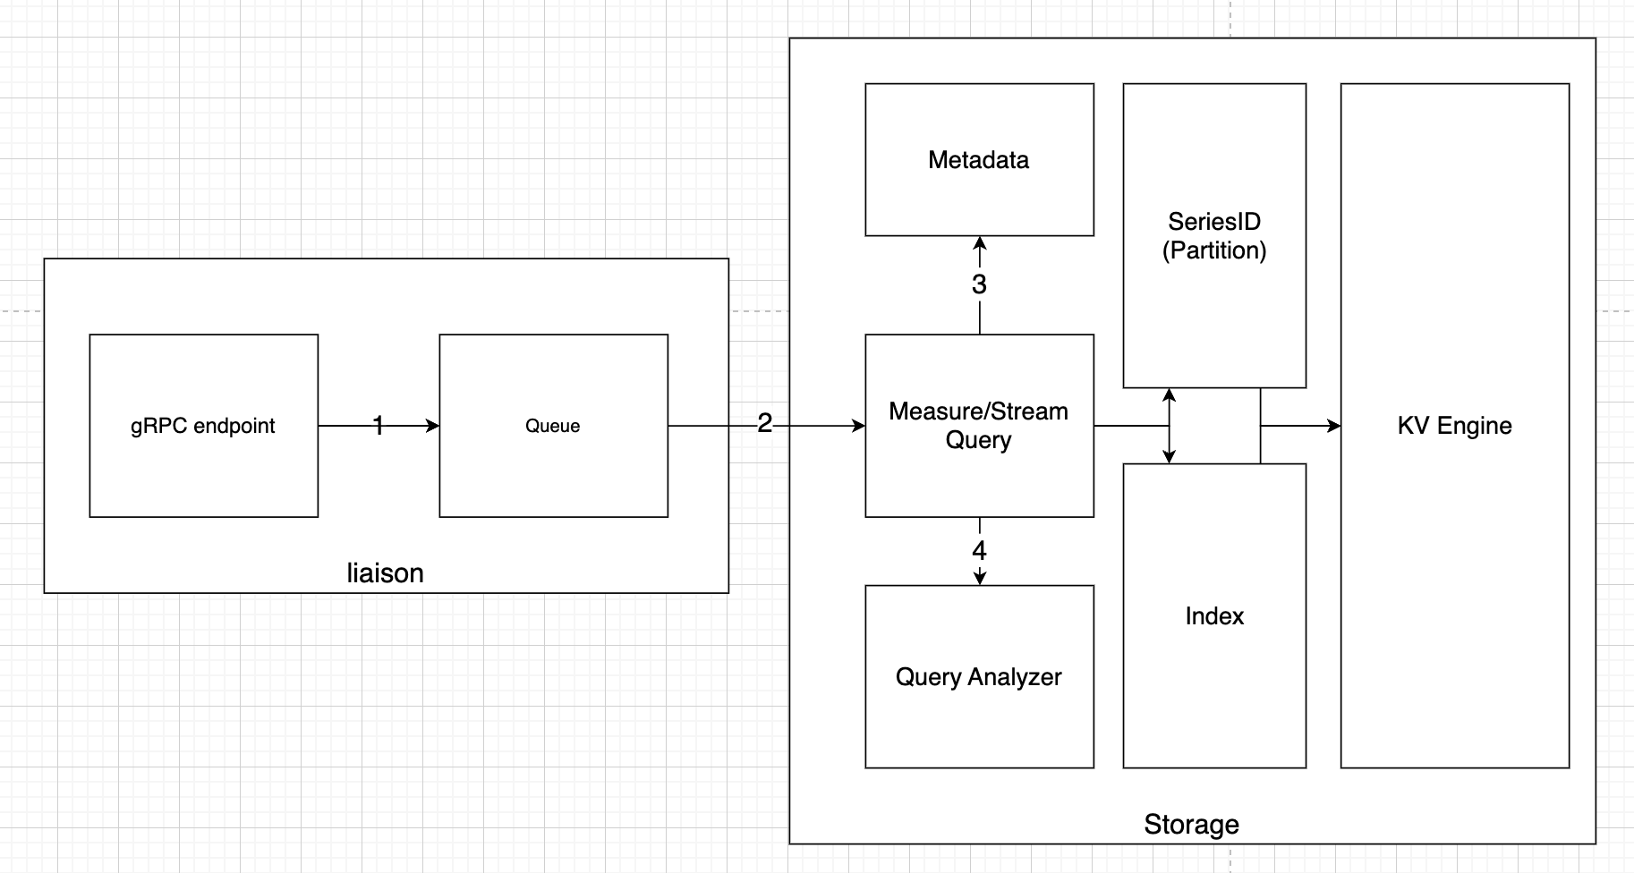
Arch

Slide 13
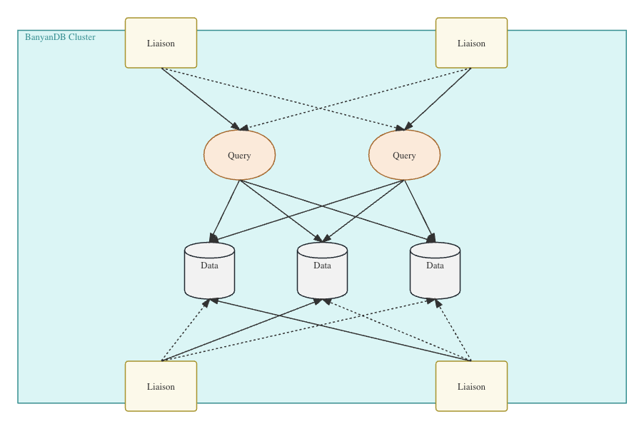
Distributed

Slide 14
Data Ingestion

Slide 15
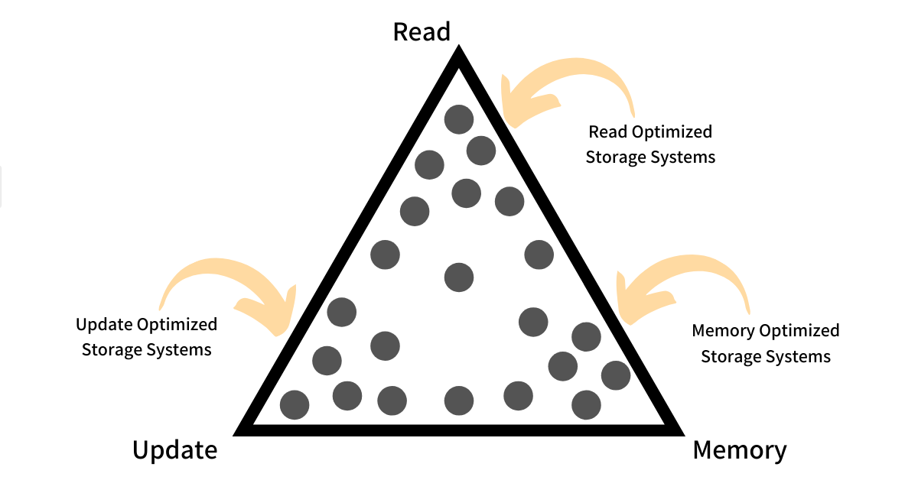
Rum Conjecture

Slide 16
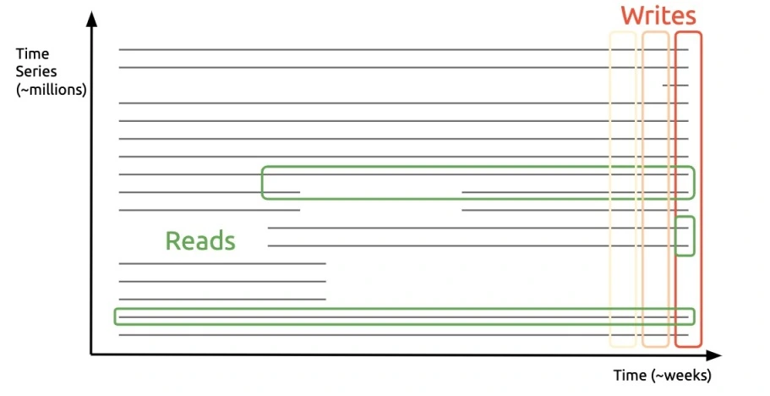
BanyanDB Access Method
Vertical write
Horizontal read
Insertions >> lookups
Old data is less likely to be access

Slide 17
Compression based on Series

Slide 18
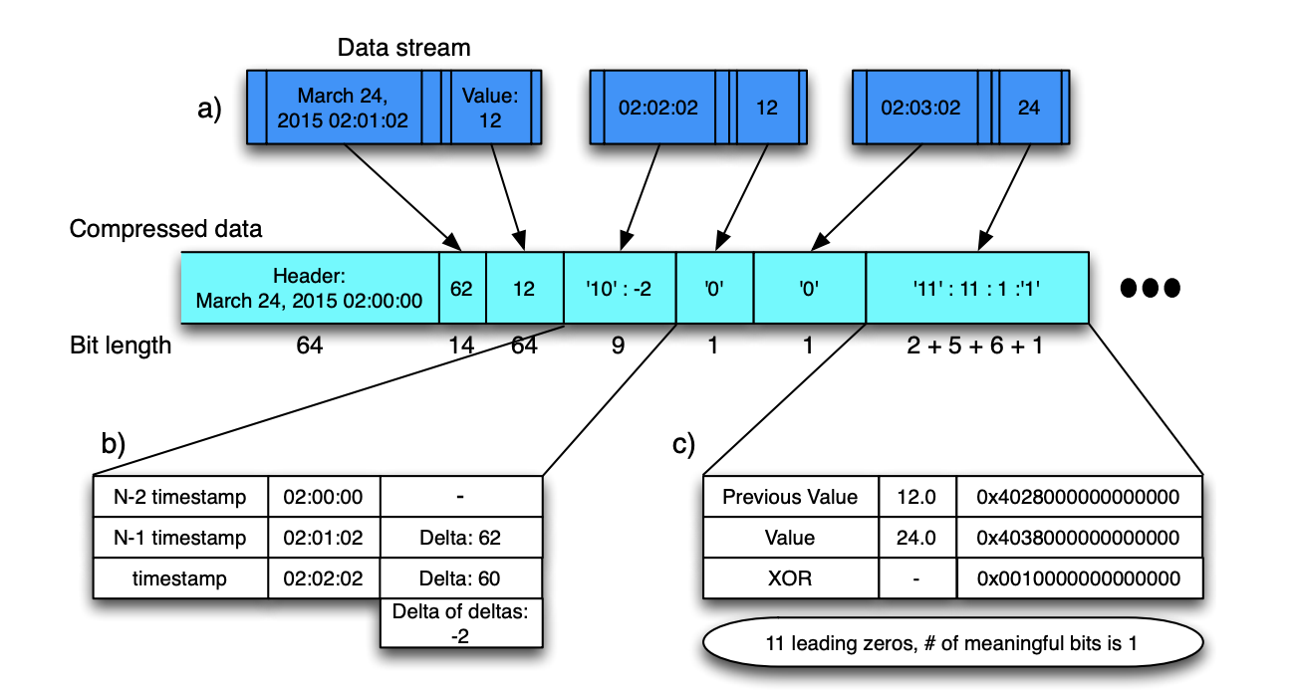
Compression Alogrithm
Enhanced Gorilla
Facebook Gorilla:
Timestamp: fixed interval => derived timestamp
Value: XOR
Compress big chunk

Slide 19
Compression Ratio

Slide 20
Query Engine

Slide 21
Query Engine

Slide 22
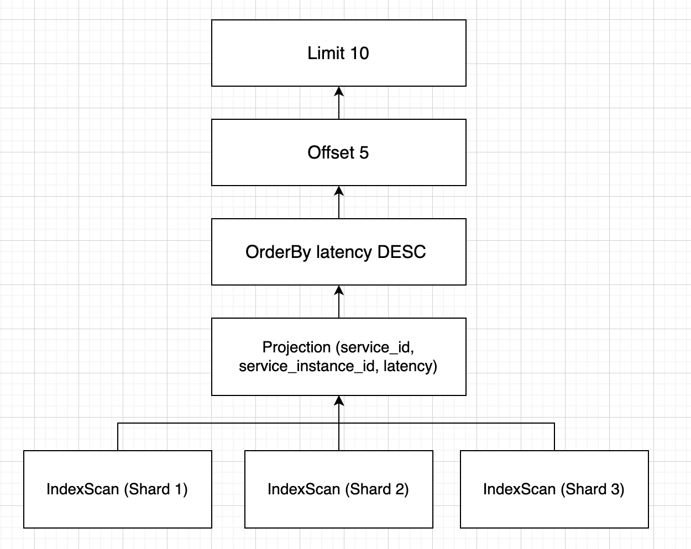
Volcano Model
Iterator
Open()
Next()
Close()
SELECT service_id, service_instance_id, latency
FROM service_instance_cpm
WHERE zone = “Shanghai”
ORDER BY latency DECS
OFFSET 5
LIMIT 10

Slide 23
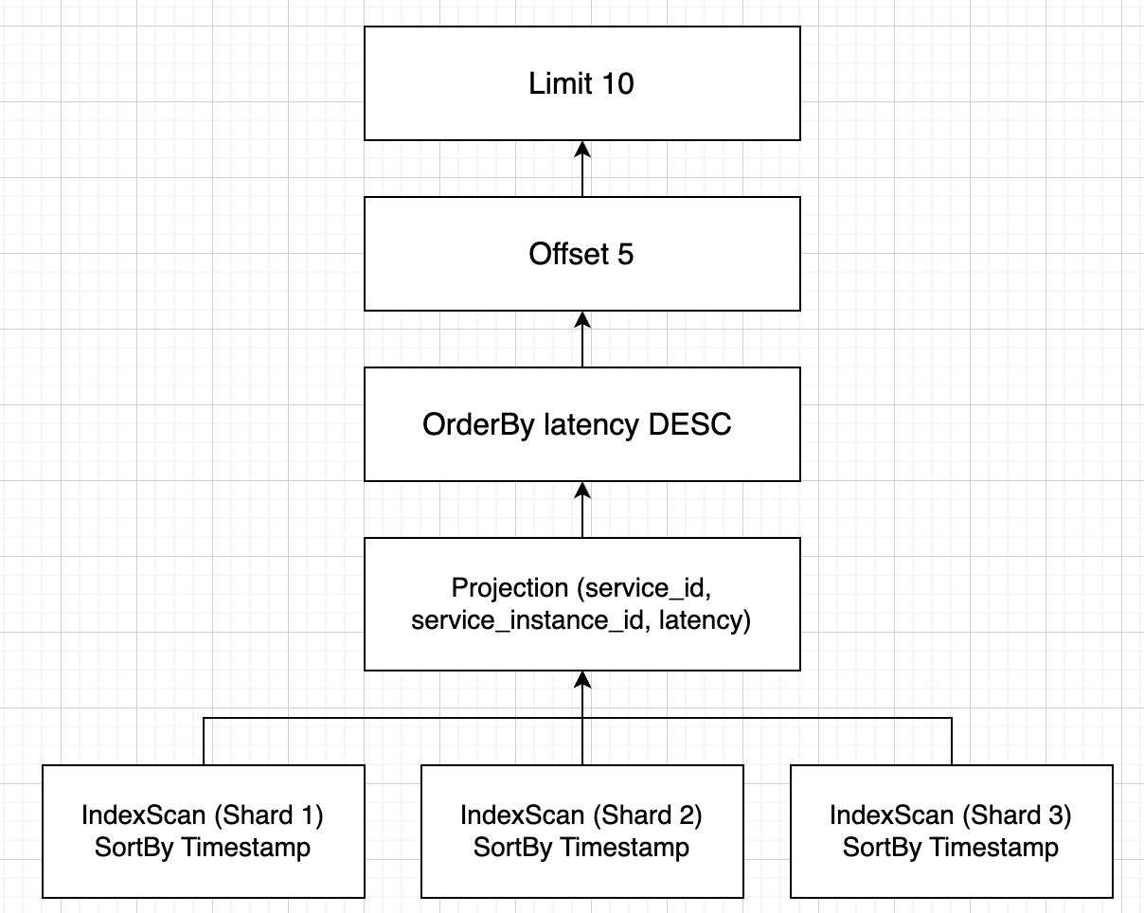
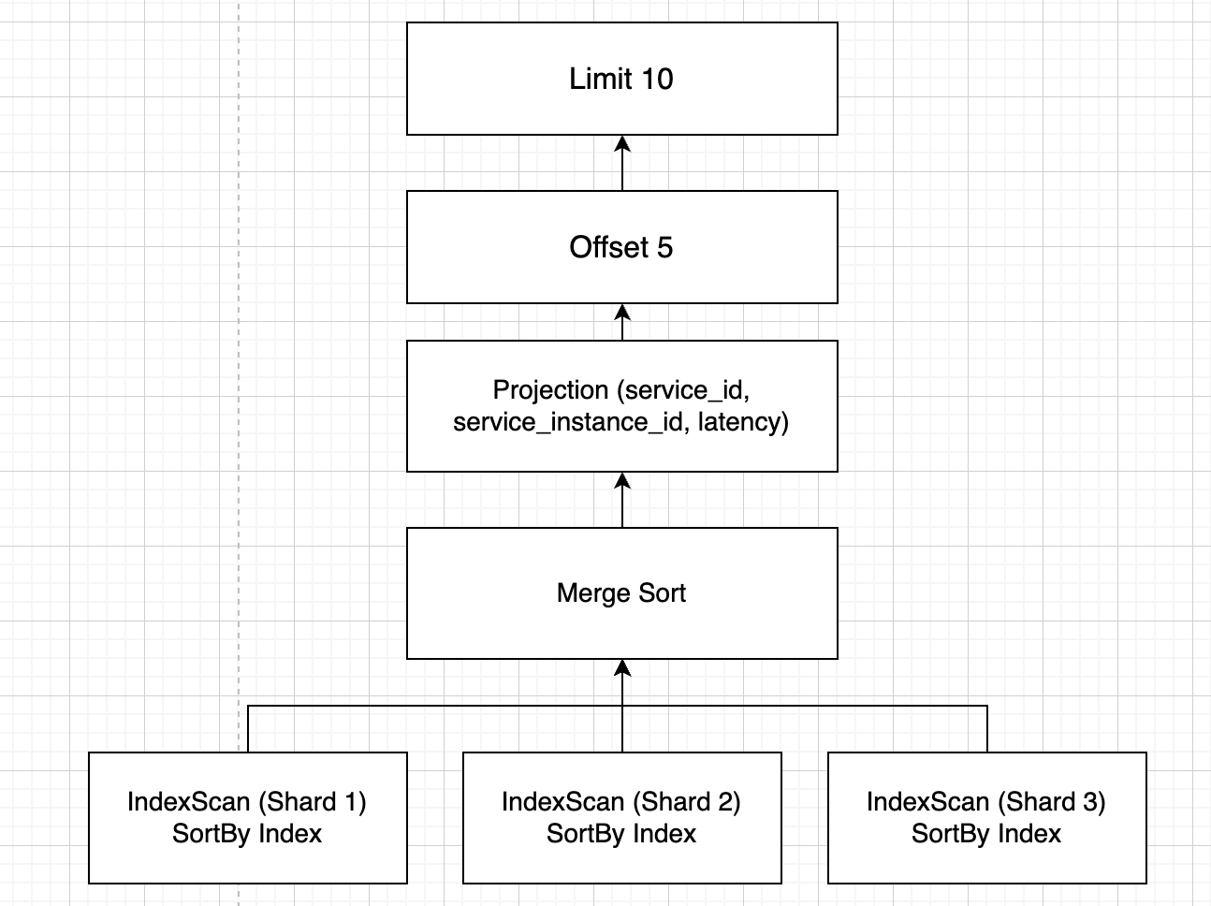
Plan Optimizer
Push Down
optimizing…

Slide 24
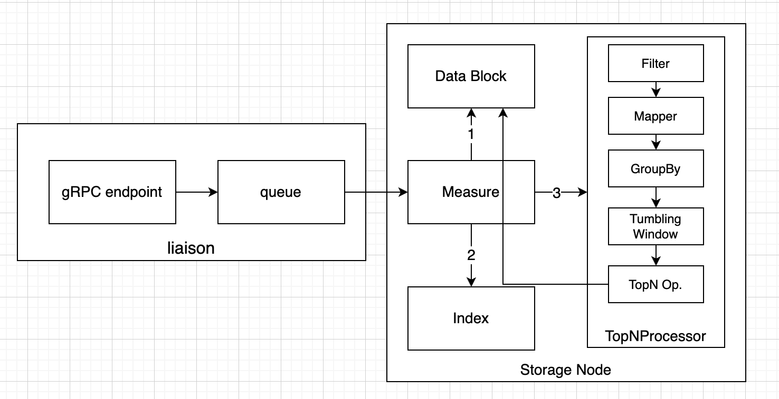
Streaming Pipeline
TopN Aggregation

Slide 25
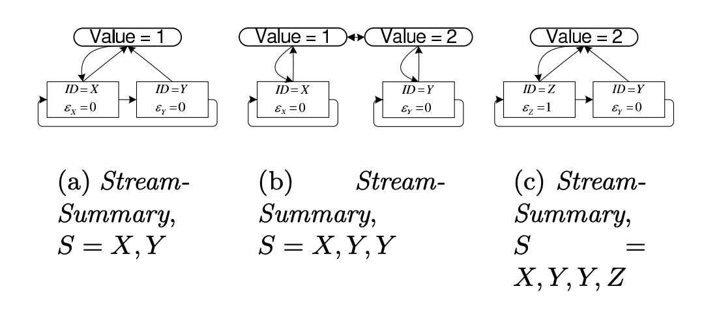
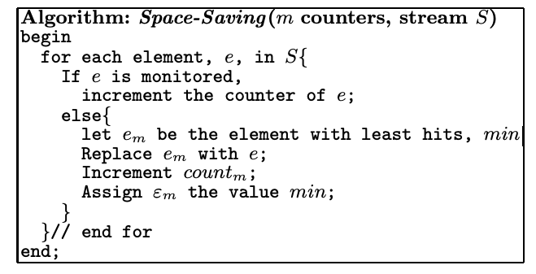
Top-k Sort

Slide 26
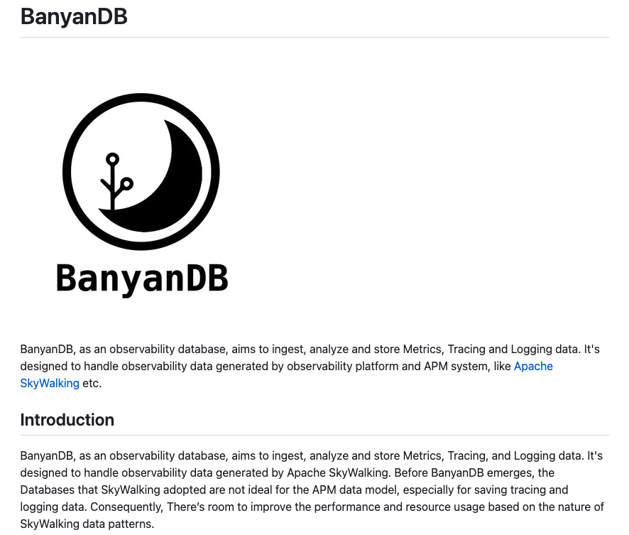
BanyanDB
https://github.com/apache/skywalking-banyandb/

Slide 27
THANK YOU
QUESTIONS?
欢迎扫码打卡
积分可兑换对应礼品哟！
扫码添加讲师联系方式

