Slide 1
Building Linux Distribution from Scratch with Rust
Speaker: Jia Xiaoyu

Slide 2
Why we choose rust？

Slide 3
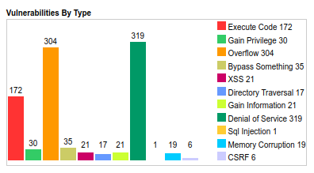
Why do we want to use Rust to build most of the things in the Operating system？
If you have a very large (millions of lines of code) codebase, written in a memory-unsafe programming language (such as C or C++), you can expect at least 65% of your security vulnerabilities to be caused by memory unsafety.
Security issues can happen not only in the kernel, but also in the whole system, which includes the kernel and the system software.
The number of vulnerabilities by type in the GNU since 1999 (data from: CVE Details)

Slide 4
Using Rust and LFS build linux distro

Slide 5
What rust-related things have happened in the kernel since the release of kernel 6.1?
Linux 6.1: Officially Adds Support for Rust in the Kernel
Kernel internals (kallsyms expansion for Rust symbols, %pA format)
Kbuild infrastructure (Rust build rules and support scripts)
Rust crates and bindings for initial minimum viable build
Rust kernel documentation and samples
Possible to create "hello world" module
Linux 6.1～Linux 6.4 : What ‘s new?

Slide 6
How to build rust support Kernel?
Require:
rustc,rust-src(cross-compile core and alloc),rust-bindgen
llvm(clang)
make LLVM=1 rustavailable
make CC=clang rustavailable
Compile kernel
make LLVM=1(CC=clang) rustavailable
enbale Rust support in the General setup
Other thing
gccrs in development
Happing Hacking

Slide 7
Benefits of using LFS to build linux distributions
What is LFS?
Linux From Scratch(LFS) is a project that provides you with step-by-step instructions for building your own custom Linux system, entirely from source code.
Benefits:
highly customizable
lightweight
full control
Steps:
Prepareing for the Build
Build Cross Toolchain and Temporary Tools
Build Basic System Software(73)
System Configuration
Make it bootable

Slide 8
Rust Env
Kernel rust support
Rust Application
Not Customizable
Customizable
Cross compile toolchains
Temp tools
System Application
Kernel and boot

Slide 9
Challenges of using LFS to build linux distributions
It requires a lot of time and effort, as well as a certain level of technical skill and experience.
It requires regular manual maintenance of the system, to keep the software and the kernel up to date.
It requires solving compatibility or dependency issues that may arise during the compilation process.

Slide 10
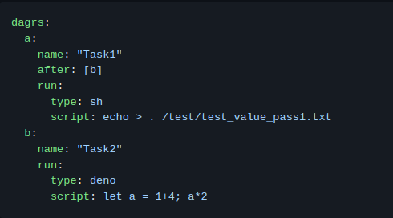
Automake the build process using the rust language
dagrs:DAG execution engine is a high-performance multi-task execution engine.

Slide 11
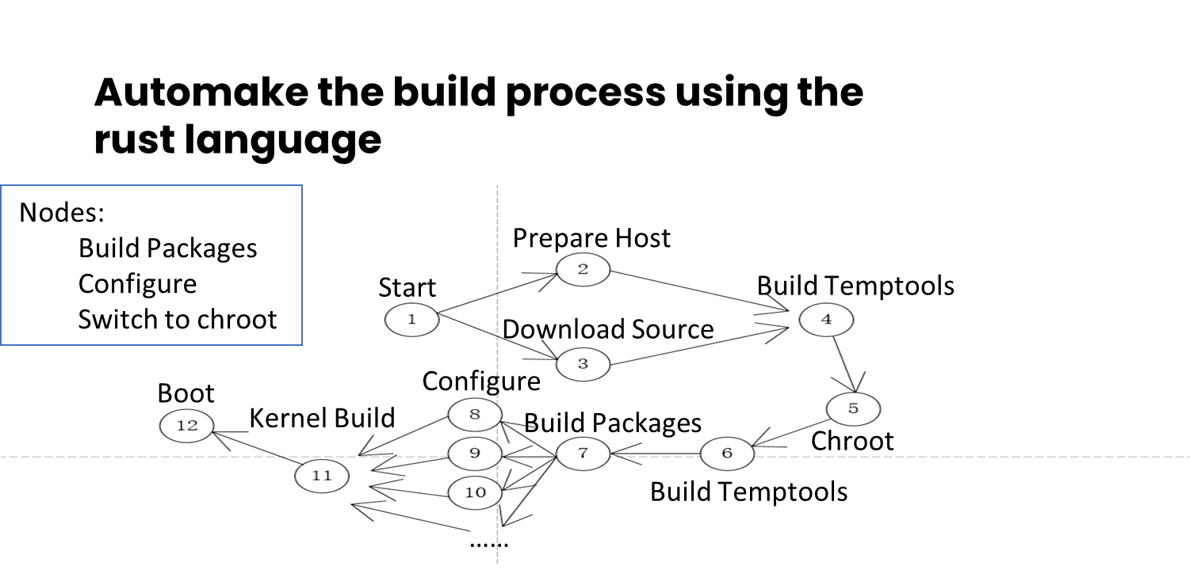
Automake the build process using the rust language
nodes
Build Package
Configure System
Switch between chroot and real root
DAG：

Slide 12
What rkos brings us?

Slide 13
Rust kernel programing
More System application with rust
…….
Uutils coreutils: a cross-platform reimplementation of the gnu coreutils in Rust
Ripgrep:ripgrep is faster than {grep, ag,glt,grep,ucg,pt,sift}
Sudo-rs: A safety oriented and memory safe implementation of sudo and su written in Rust
Ntpd-rs:ntpd is an NTP implememtation written in Rust,with a focus on security and stability.
Trust-DNS:A Rust based DNS client, server,and Resolver,built to be safe and secure from the ground up.
…….

Slide 14
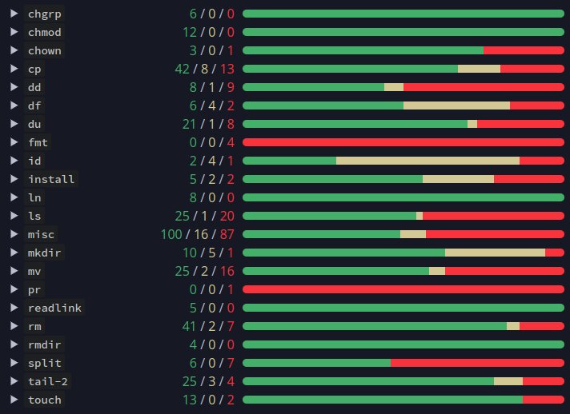
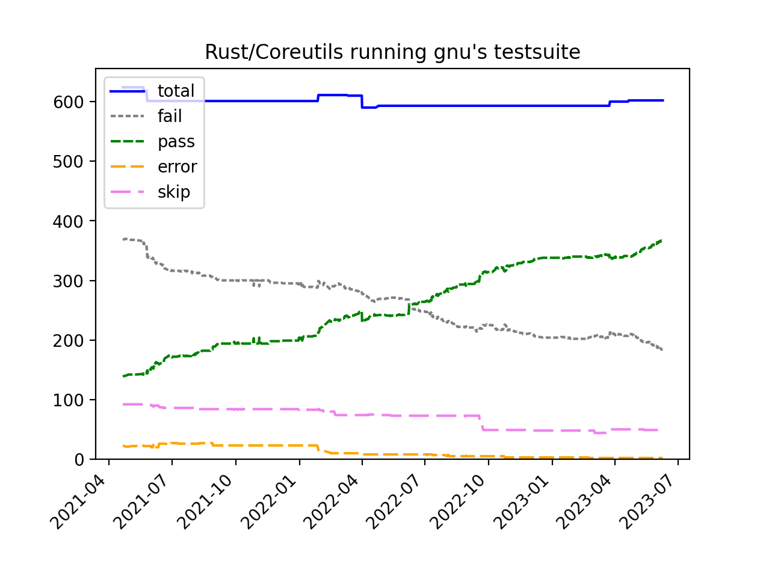
Uutils/Coreutils

Slide 15
Rust kernel programing

Slide 16
Planning
rkos-builder:Wait for the stable release of dagrs, and then refactor rkos-builder.
rkos:
The focus will be on building a clean and reliable foundation environment.
Support more applications developed by Rust.

Slide 17
Appendix
CVE Deatils: https://www.cvedetails.com/vulnerabilities-by-types.php
RKOS:https://github.com/open-rust-initiative/rkos
dagrs:https://github.com/open-rust-initiative/dagrs
uutils/coreutils:https://github.com/uutils/coreutils
LFS:https://www.linuxfromscratch.org/

Slide 18
THANKS

