Slide 1
为什么说WordPress是世界上最好的CMS？
白宦成，Linux 中国开源社区

Slide 2
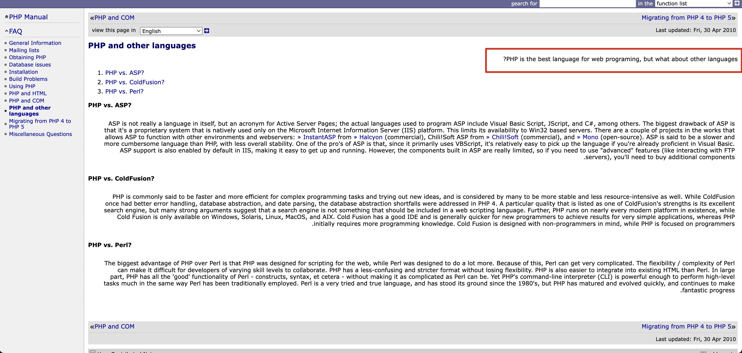
PHP 是世界上最好的语言！
Notes:
大家都知道，之前

Slide 3
数据来源：https://w3techs.com/technologies/overview/programming_language

Slide 4
WordPress 是世界上最好的 CMS

Slide 5
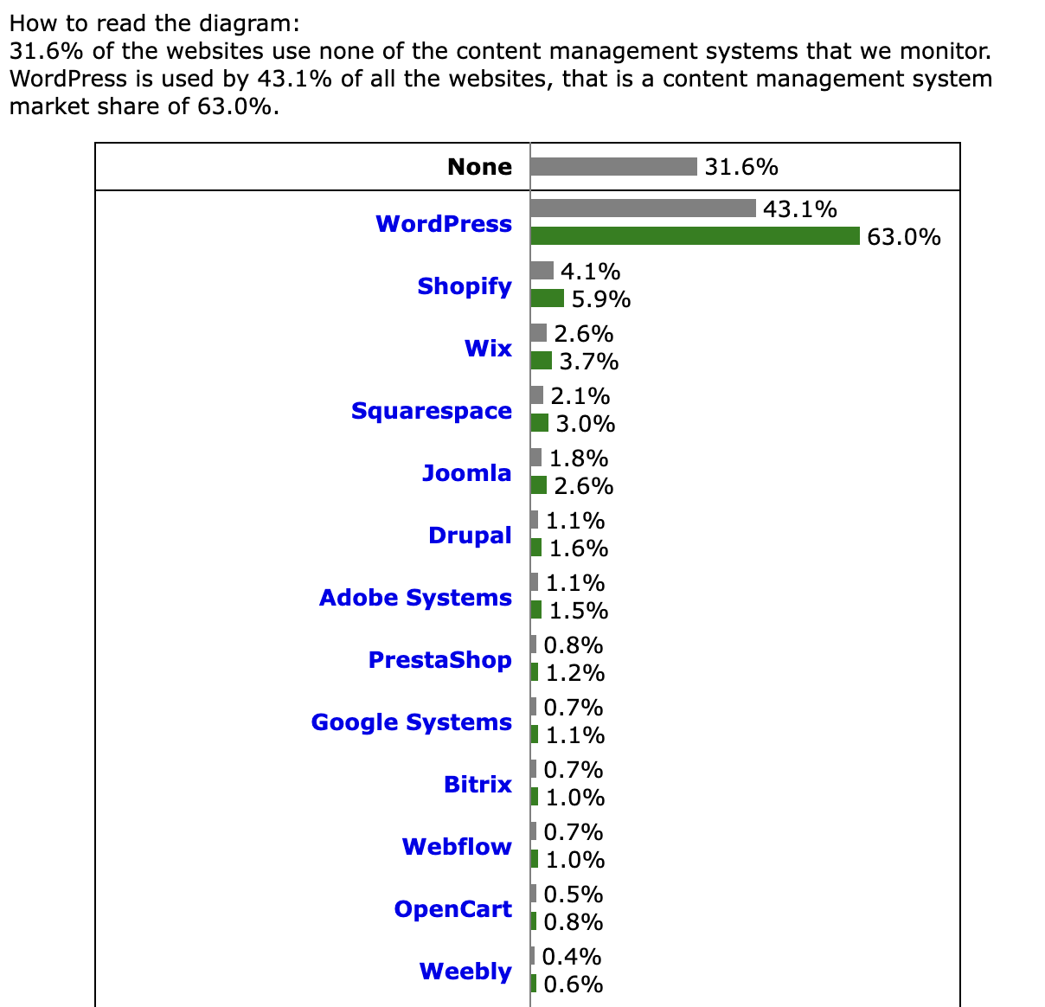
数据来源：https://w3techs.com/technologies/overview/content_management

Slide 6
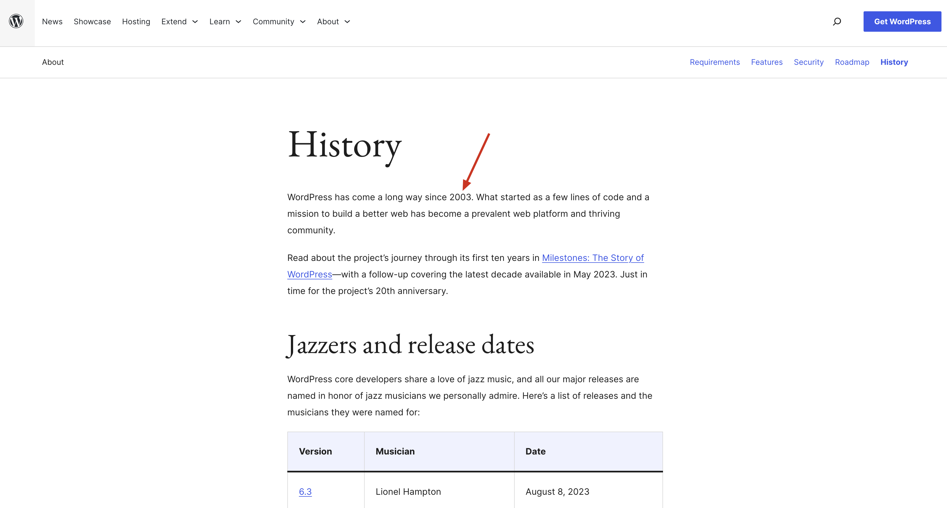
WordPress 是经历周期验证的

Slide 7
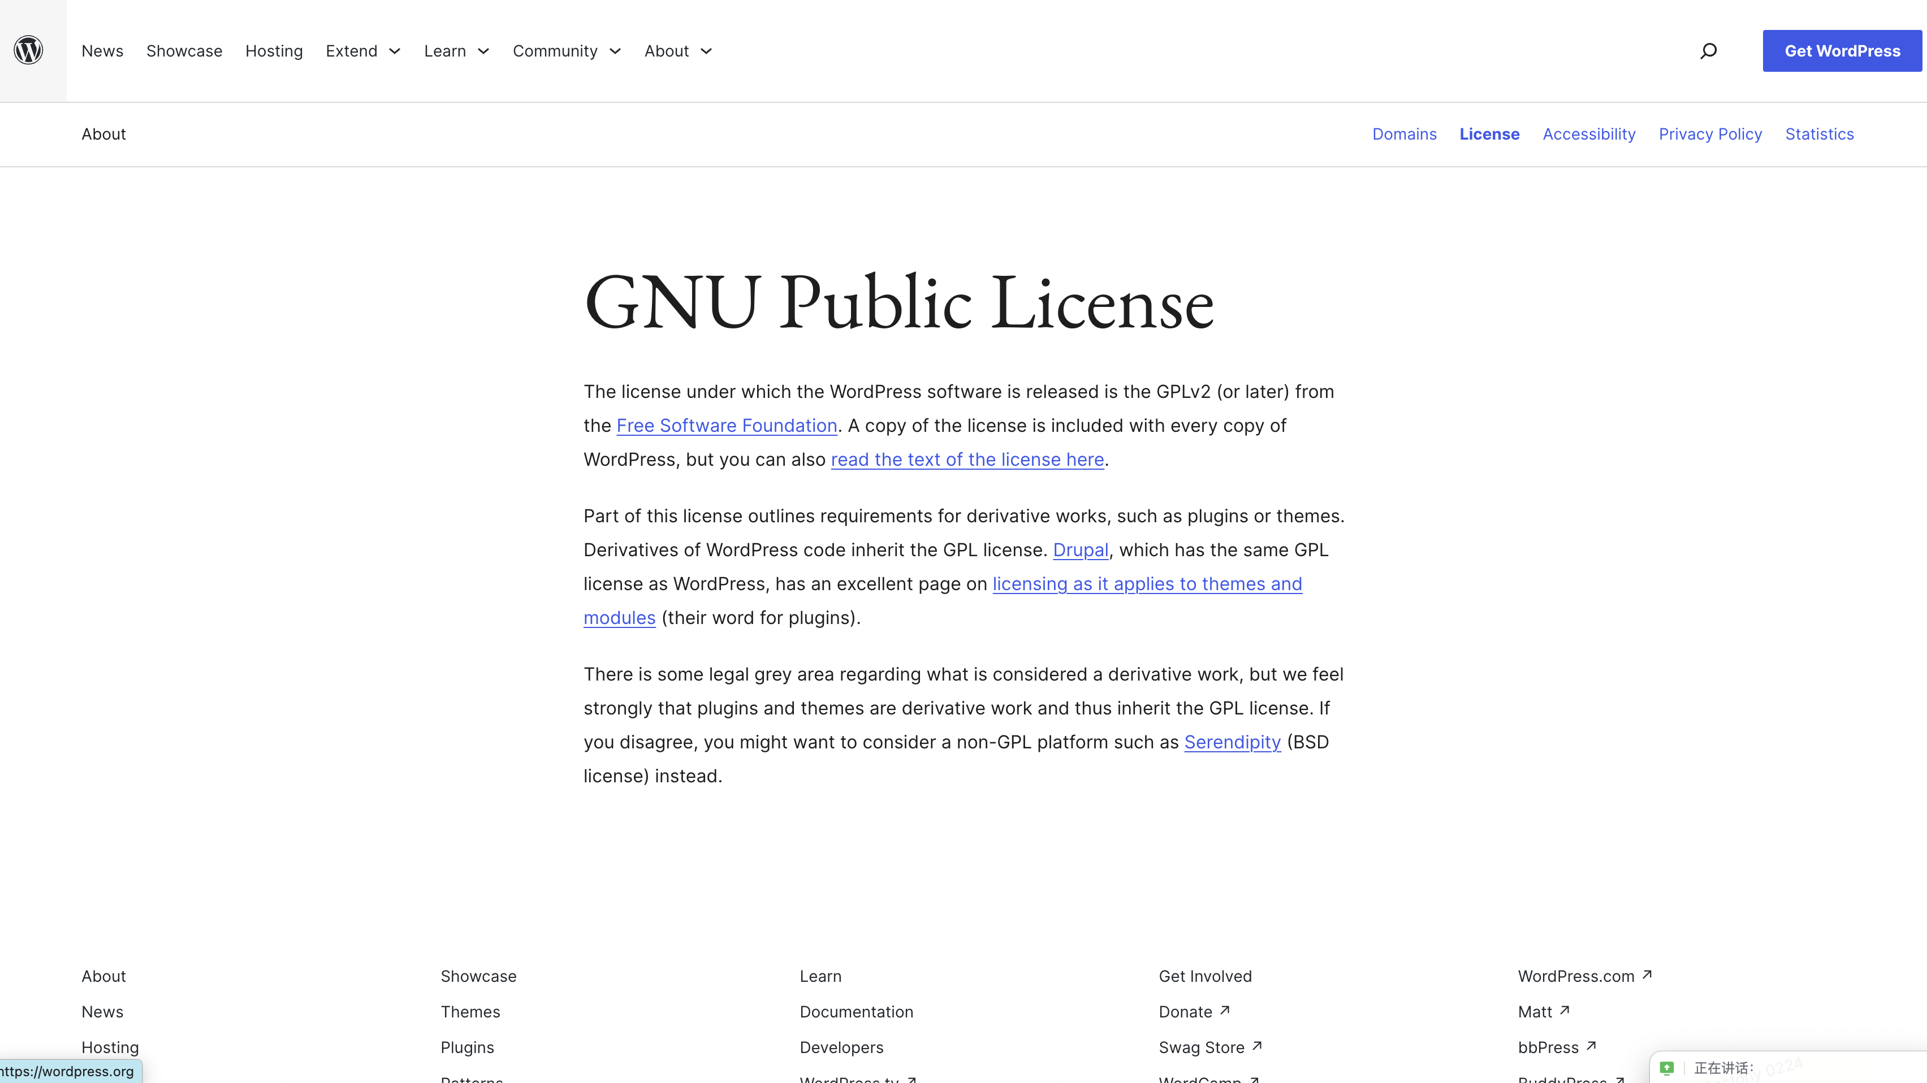
WordPress 是开源的！

Slide 8
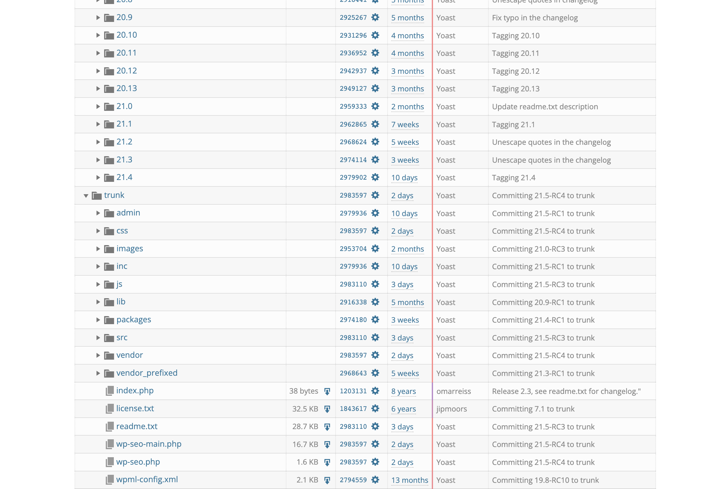
开源的插件/主题

Slide 9
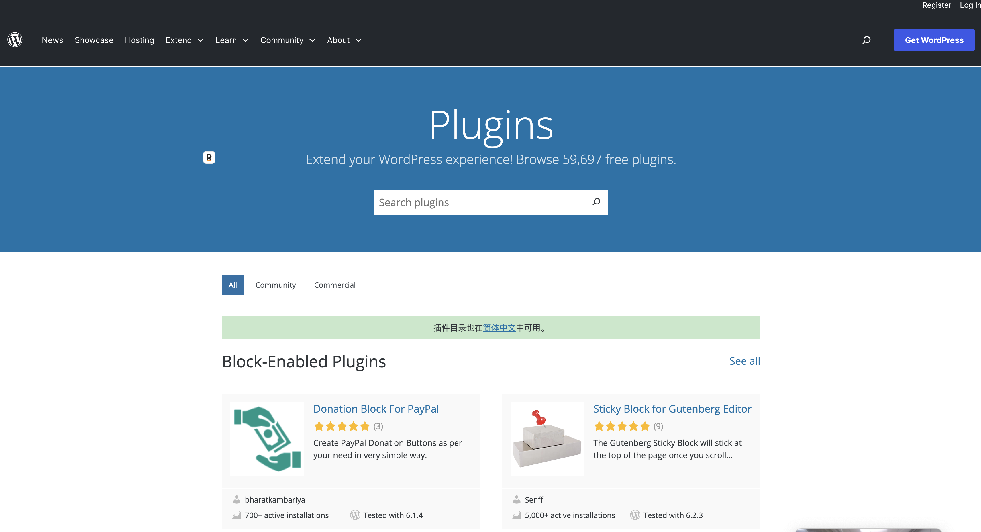
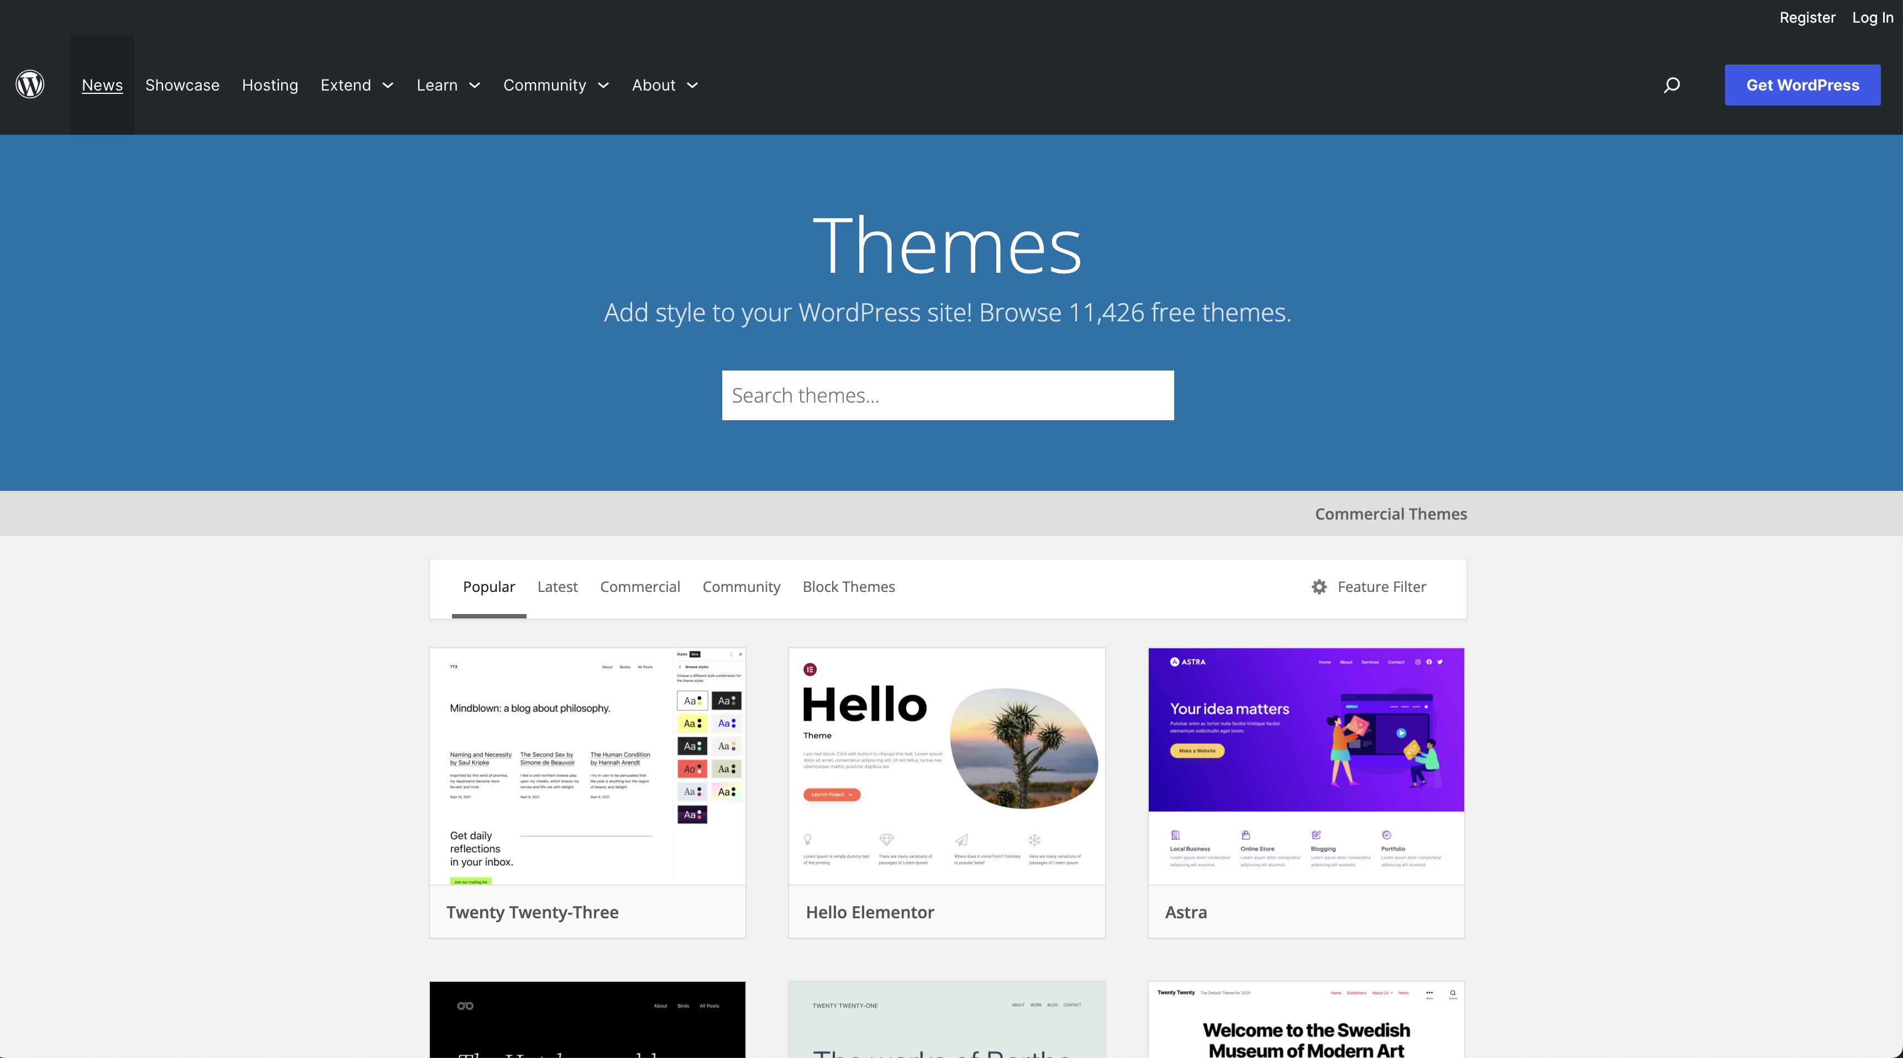
WordPress 的生态

Slide 10
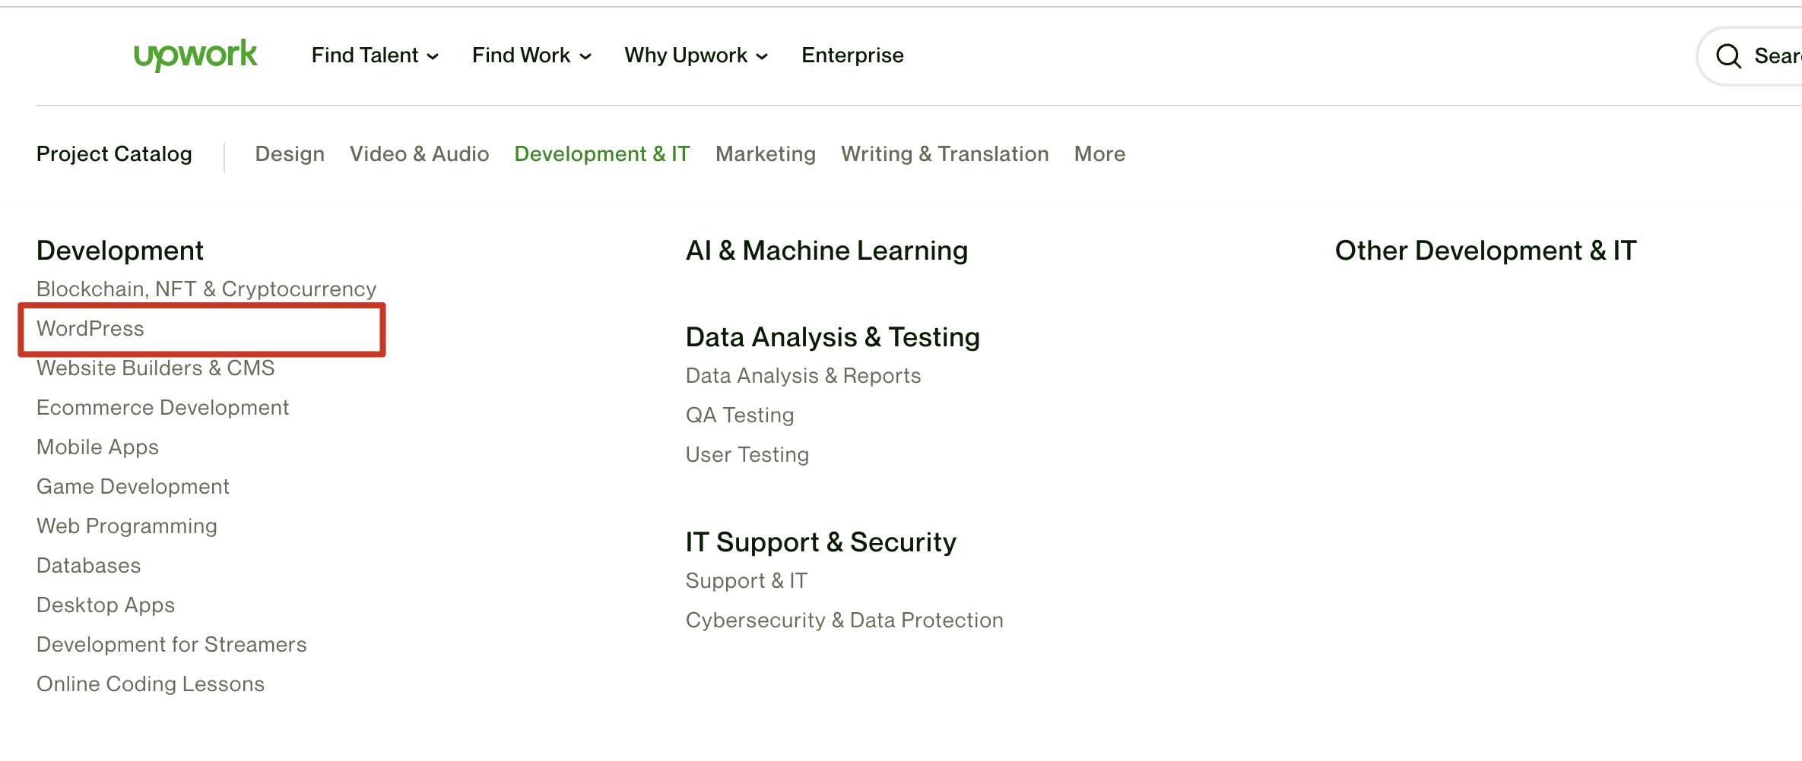
WordPress 的生态

Slide 11
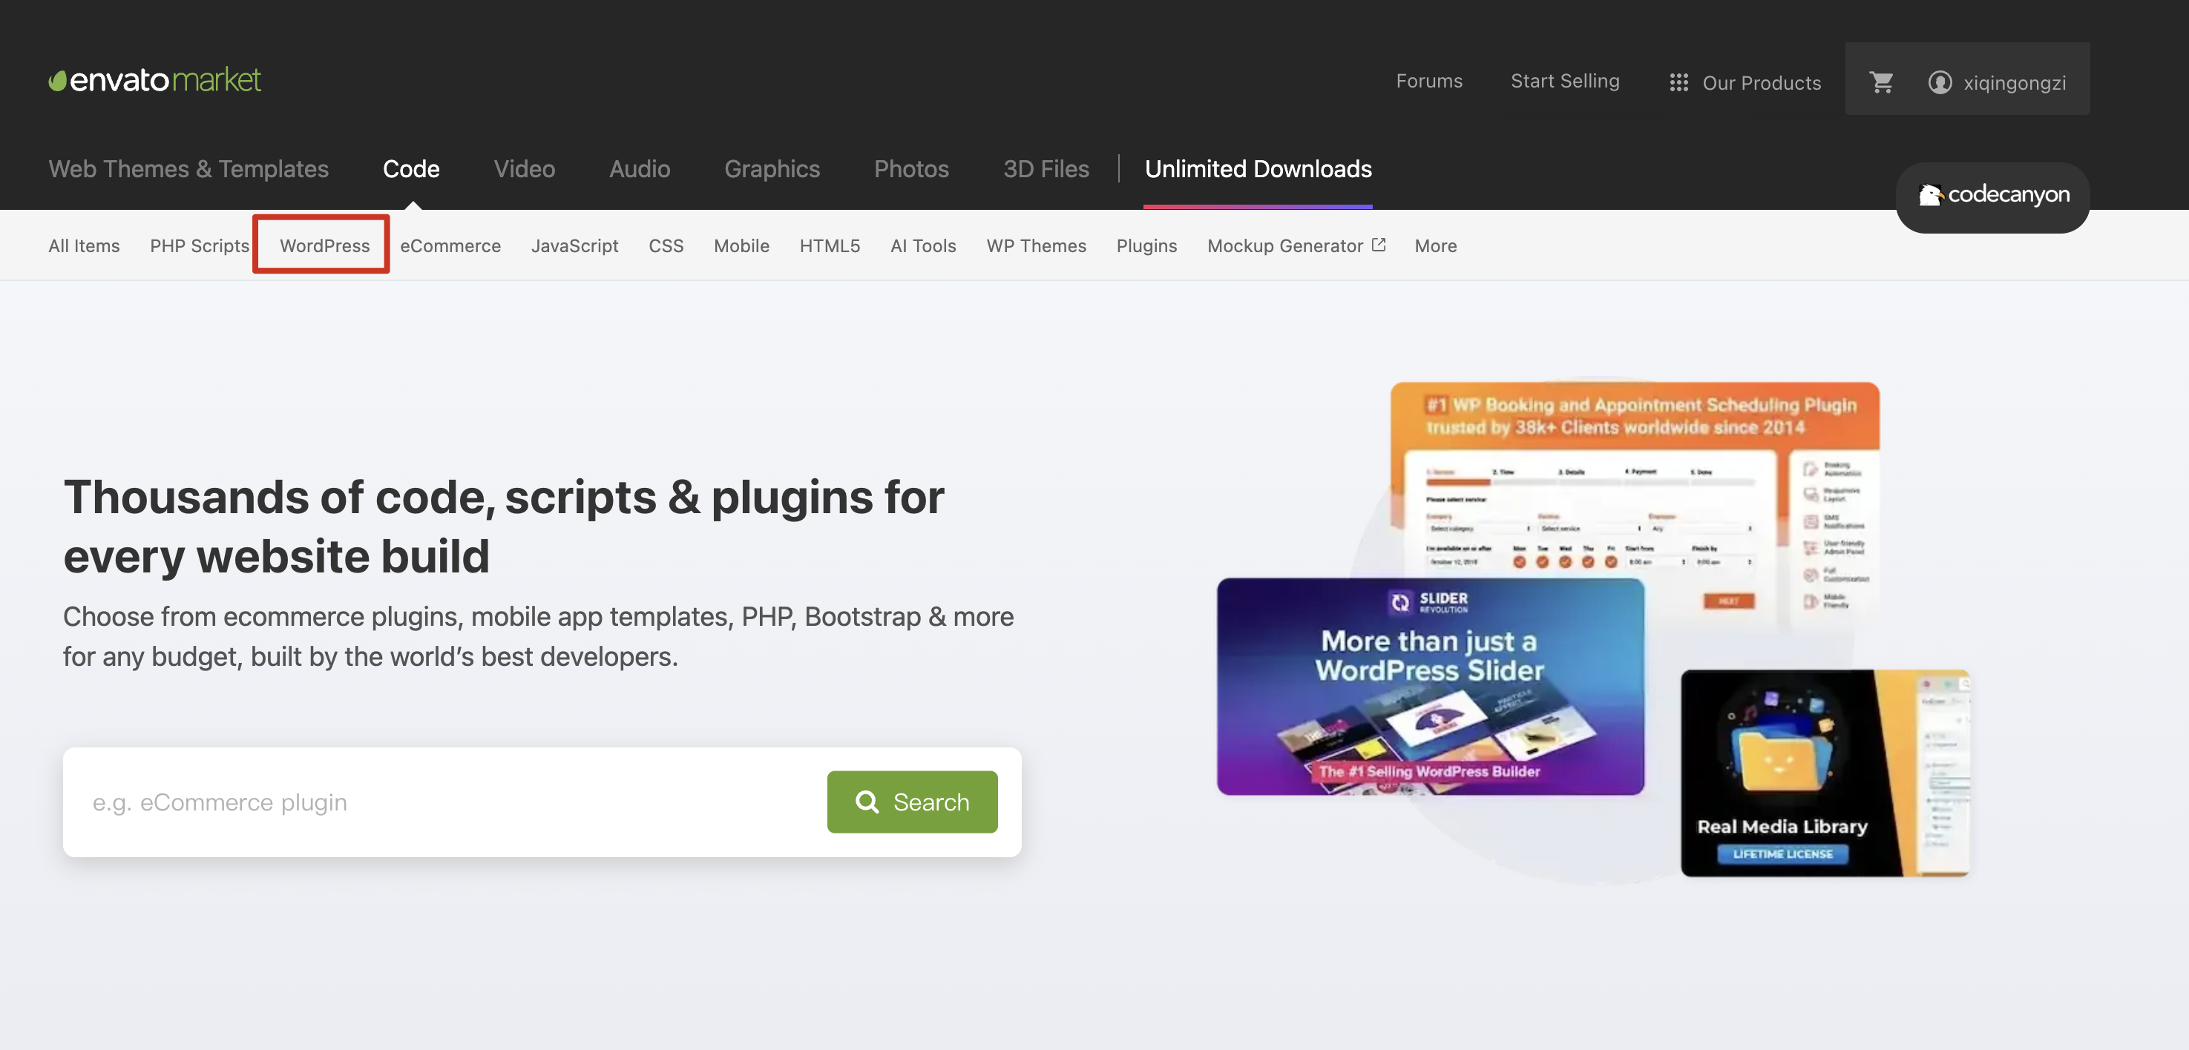
WordPress 的生态

Slide 12
WordPress 的生态

Slide 14
目录
CONTENTS
01
标题一
02
标题二
03
标题三
04
标题四

Slide 15
标题一
Furthermore, monthly public wrap-up meetings are being held increasingly in order to put on record the work done by the Security Council and to elicit the views of members of the General Assemb.
Furthermore, monthly public wrap-up meetings are being held increasingly in order to put on record the work done by the Security Council and to elicit the views of members of the General Assemb.

Slide 16
标题二
开源
川流不息
山海相映
A day is a miniature of eternity.
A day is a miniature of eternity.
A day is a miniature of eternity.

Slide 17
标题三
模块标题
副标题

Slide 18
THANK YOU
QUESTIONS?
扫码添加讲师联系方式

