Slide 1
Rust 忽略的二三事
Ignore Things in Rust Test
Antonio from COSCUP

Slide 2
目录
CONTENTS
01
Test in Rust
02
Things Rust Ignored
03
Quick Solution
04
Example with Test Runner

Slide 3
Test in Rust
Test cases
Examples
Documents
Features
kana hata @ flicr CC BY-NC-SA

Slide 4
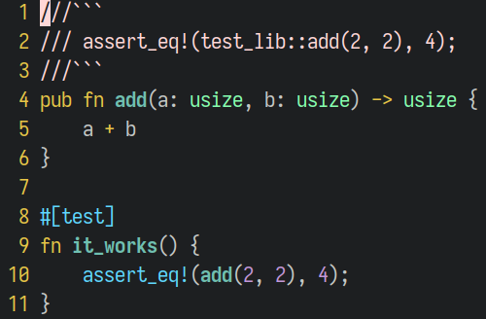
Test in Rust - Basic
Cargo test

Slide 5
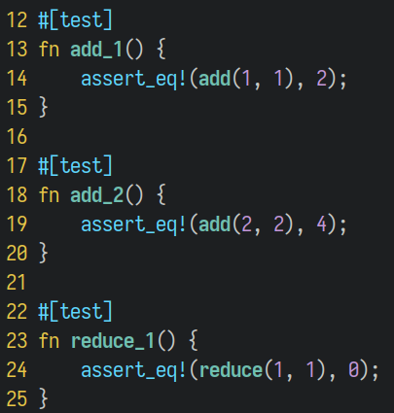
Test in Rust - With Filter
Cargo test add_

Slide 6
Test in Rust - By Example
Cargo test add_

Slide 7
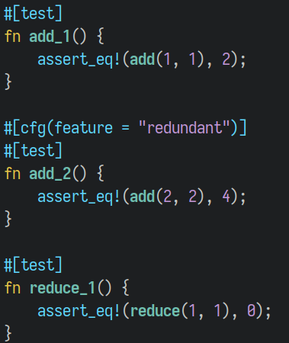
Test in Rust - By Features
Cargo test --features=redudant

Slide 8
Test in Rust
It is awesome, but…
manually not smart

Slide 9
Test in Rust
Could the test case be smart?
Why just cargo test

Slide 10
Test in Rust
Just cargo test
it is smart
and it knows it should run or not,
and report the status

Slide 11
Things Rust Ignored
Ignored message
Check condition
Dom Sagolla @ flicr CC BY-NC-ND 2.0

Slide 12
Things Rust Ignored
#[ignore=”because the cpu core less than 32”] fn test() {...}

Slide 13
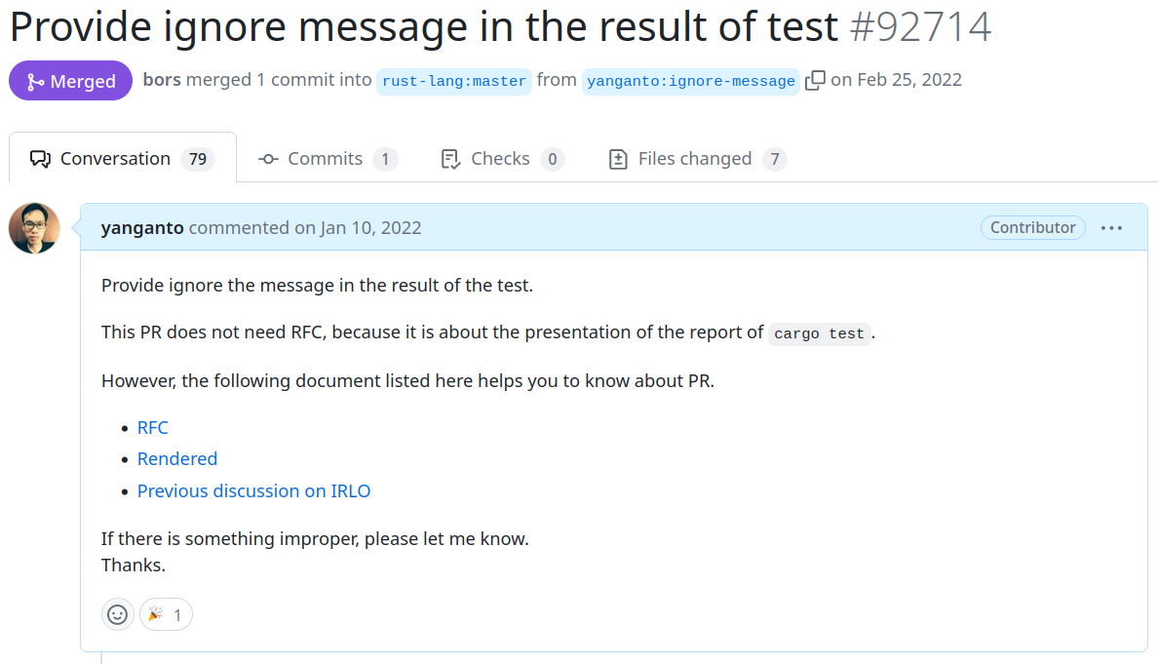
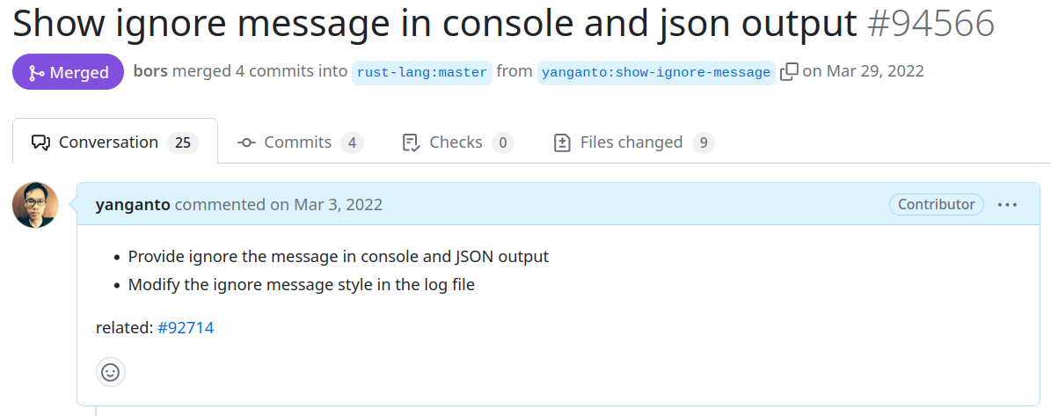
Things Rust Ignored
Ignore message works after 2022
Land on Rust 1.61
#92714 #94566
Rfc #94566

Slide 14
Things Rust Ignored
Great, then we need the other part
check condition in test

Slide 15
Things Rust Ignored
Run test when corresponding component existing
Ignore when corresponding component is non-existing
Test

Slide 16
Things Rust Ignored
Run test when envar existing
Ignore when envar absent
Test
Issue #68007 opened in 2020

Slide 17
Things Rust Ignored
It is 2023, but…
we can not check condition in test
and why?

Slide 18
Things Rust Ignored
Each Rust test will be function,
and return a Result<...>

Slide 19
Things Rust Ignored
Each Rust test will be function,
and return a Result<...>
Ok() map to Pass, Err() map to Fail

Slide 20
Things Rust Ignored
Ignore should be decide before function build
Each Rust test will be function,
and return a Result<...>

Slide 21
Things Rust Ignored
Wait!
There is still something similar call panic!
It happened when function runs

Slide 22
Things Rust Ignored
fn some_function () {
panic!("some message")
}
#[test] fn test_case () {
ignore!("some message")
}

Slide 23
Things Rust Ignored
#[test] #[ignore] fn test_case () {
}
Parse syntax & Build
Run testcase
#[test] fn test_case () {
ignore!("some message")
}
Parse return & summary

Slide 24
Things Rust Ignored
It seems wonderful, but still break the assumption

Slide 25
Things Rust Ignored
It seems wonderful, but still break the assumption
Each Rust test will be function,
and return a Result<...>
Ok() map to Pass, Err() map to Fail
What ignore should map to?
Cargo does not support this.

Slide 26
Things Rust Ignored
Also, break the other assumption
Ignore should be decide before function build
Each Rust test will be function,
and return a Result<...>

Slide 27
Things Rust Ignored
Because breaking assumption (ignored test is static),
it will be breaking change
Run ignored and not ignored tests cargo test -- --include-ignored
Run only ignored tests cargo test -- --ignored

Slide 28
Things Rust Ignored
Hard to let Rust have a breaking change,
so do it in a crate

Slide 29
Quick Solution
Easy to use in CI
No extra dependency on release product
No extra test runner
Still cargo test
Djaesuhn.tjl @ flicr CC BY-SA 2.0

Slide 30
Quick Solution
Check condition when build
Parse syntax & Build
#[test] #[ignore] fn test_case () {
}
Run testcase
Parse return & summary

Slide 31
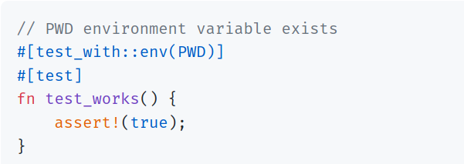
Quick Solution
// Cargo.toml [dev-dependencies] test-with = "0.7.5"
Conditions: envar, file, http service, tcp socket, user, cpu, .. etc.

Slide 32
Quick Solution
It is good,
and what is the limitation.

Slide 33
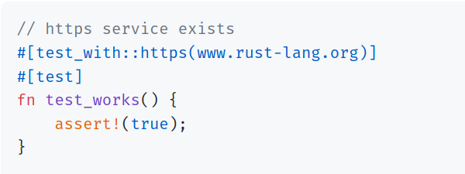
Quick Solution
cargo test when web service absent
Turn on the web service, and cargo test again
The code did not change,
so it will not build still ignored

Slide 34
Quick Solution
We need a test runner,
where should we put in?

Slide 35
Example with Test Runner
Put test in example
Provide test runner in example
Check condition in runtime
Djaesuhn.tjl @ flicr CC BY-SA 2.0

Slide 36
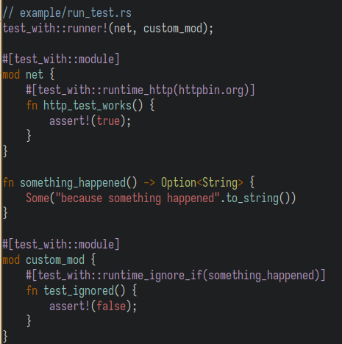
Example with Test Runner
cargo run --example run_test
// Cargo.toml [dependencies] test-with = "0.11.0" libtest-with = "0.6.1-2"

Slide 37
Example with Test Runner
The example output is the same as cargo test

Slide 38
Example with Test Runner
Still some trad-off
extra dependency
can be avoided after rfc-3424
put test case in example
does not execute with cargo test

Slide 39
THANK YOU
QUESTIONS?
扫码添加讲师联系方式

