Slide 1
开源工程化 LLM 的挑战与实践 Challenges and Practices in Open-Source LLM Engineering
Sherlock Xu, BentoML

Slide 2
Table of Contents
01
Open-Source LLMs
02
Challenges and the Missing Link
03
Bridge the Gap: BentoML
04
OpenLLM Optimization

Slide 3
Open-Source Large Language Models (LLMs)

Slide 4
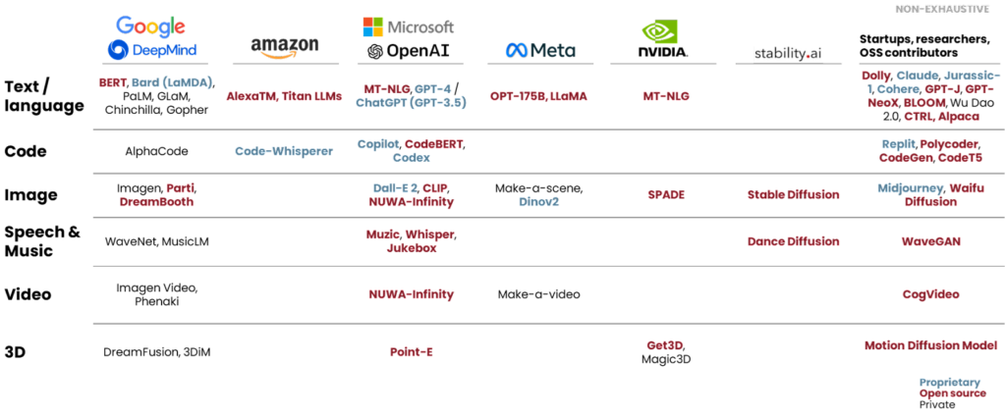
AIGC Boom

Slide 5
The Rise of Open Source LLMs like Llama 2

Slide 6
LLama 2 Factuality
Test: News report summarization
Human Performance
GPT-4
Llama 2 70B
84%
85.5%
81.7%
https://www.anyscale.com/blog/llama-2-is-about-as-factually-accurate-as-gpt-4-for-summaries-and-is-30x-cheaper

Slide 7
What Open Source LLMs Have to Offer
Customizability
Data Privacy
Cost Efficiency
Fine-tune with your own dataset for improved form and accuracy at a low cost
Deploy within your own private cloud knowing data will never leave your network boundaries or be used in training LLMs.
Pay for compute time instead of tokens. Leverage smaller but more specialized models for domain specific tasks.

Slide 8
Customizability: Domain Specific Model Refinement
Solve specific problems through fine-tuning
Full Parameter
Low Rank Adaptation (LoRA) fine-tuning
Pre-trained fine-tuned models models available in public model hubs
Low reasoning tasks outperforms GPT-4 with small parameters

Slide 9
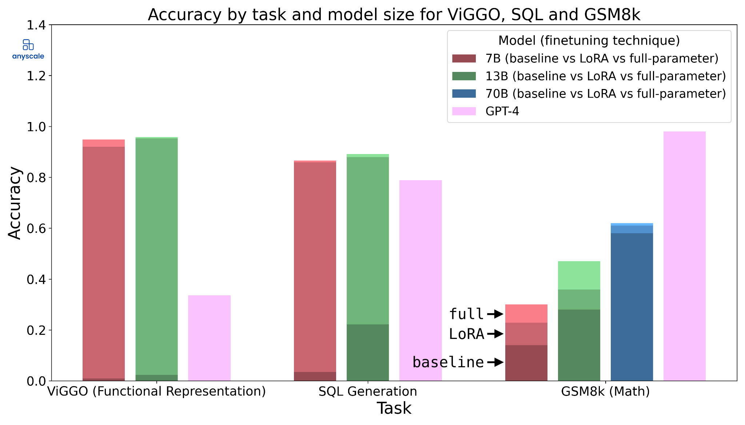
Fine-tuning
在低逻辑推理的需求下，fine-tune 较小参数的模型，推理任务胜过 GPT-4
https://www.anyscale.com/blog/fine-tuning-llms-lora-or-full-parameter-an-in-depth-analysis-with-llama-2

Slide 10
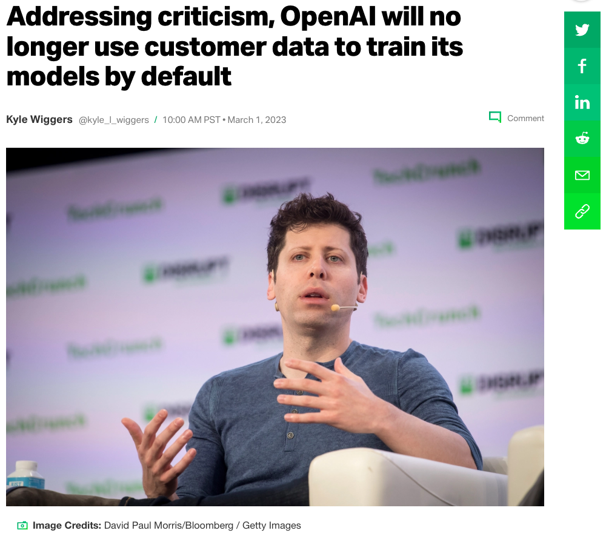
Data Privacy
Your data will not be used to train LLMs
Run within your own virtual private cloud so your data will never leave your network boundaries
Transparent training data source
Less susceptibility to provider outages
Notes:
Technique to extract training data from LLMs

Slide 11
Cost Efficiency
Commercial LLMs charges by tokens and context sizes
Fine-tuned models are 6X more expensive
Agent based or chat based applications need multiple round trips
Pay for only hardware cost with open source LLMs
No extra cost for running fine-tuned models
Better efficiency when LLMs working in production at scale
Right sizing LLM parameter sizes for the tasks
Notes:
Not everything needs GPT-4. People under estimates how BERT can be for simple classification tasks. And it runs on CPU.

Slide 12
Challenges

Slide 13
Challenges in Productionizing LLMs
Operability
Scalability
Throughput
Latency
Can I deploy and serve the model reliably on hardware I have available?
Can I scale serving instances elastically while maintain high availability?
Can I respond to a large number of concurrent text generation efficiently?
Can I respond with a reasonable delay to both APIs and human users?
Cost
How much do I need to spend to run my open source LLMs?

Slide 14
The Missing Link
？
App
Model
ML
Code
Sculley, D., et al. "Hidden Technical Debt in Machine Learning Systems." 2015.

Slide 15
The Missing Link
Model
Build
Artifact
Deploy
App
Build Challenges:
Model Packaging
Environment Management
Model Versioning
Multiple Models Management
Custom Business Logic
……
Deploy Challenges:
Environment Consistency
Scalability
Observability
Resource Management
Rolling Updates & Rollbacks
……

Slide 16
BentoML
The Unified AI Application Framework

Slide 17
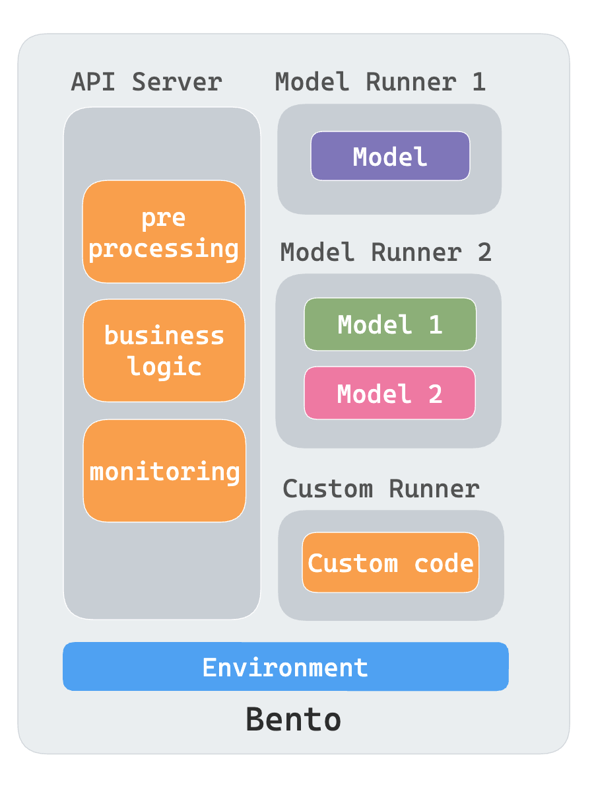
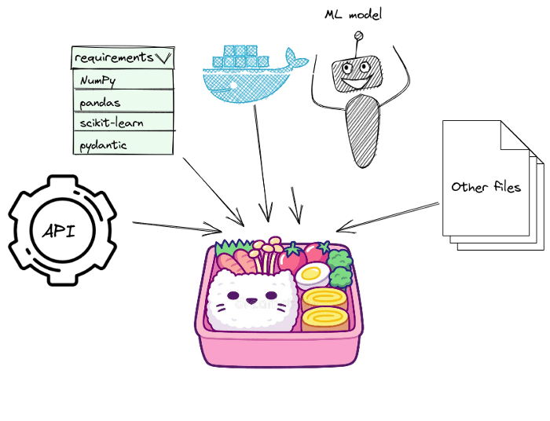
Bridge the Gap: BentoML
Model
Build
Bento 🍱
source
https://github.com/bentoml/bentoml

Slide 18
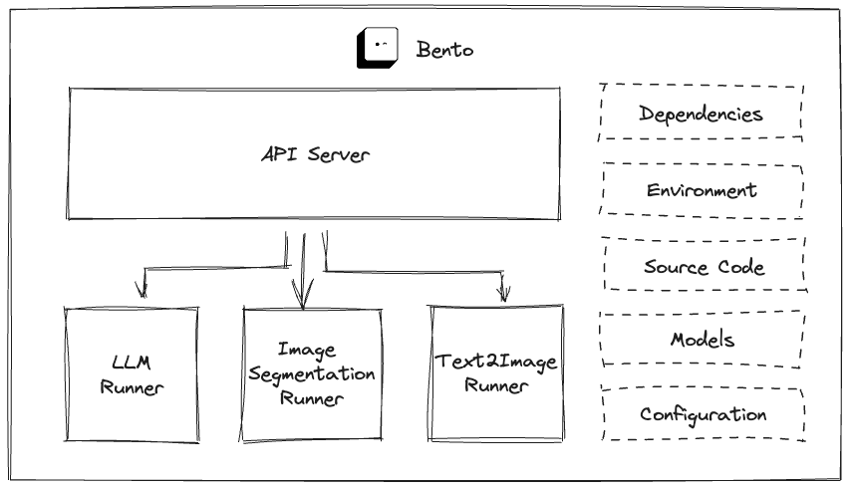
BentoML Architecture

Slide 19
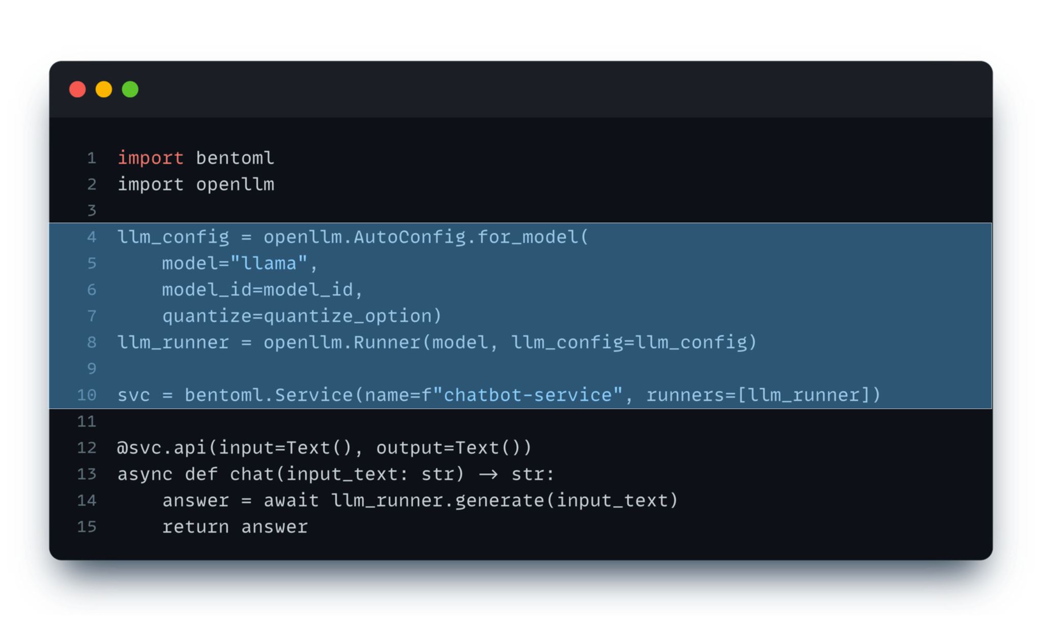
Bento Service

Slide 20
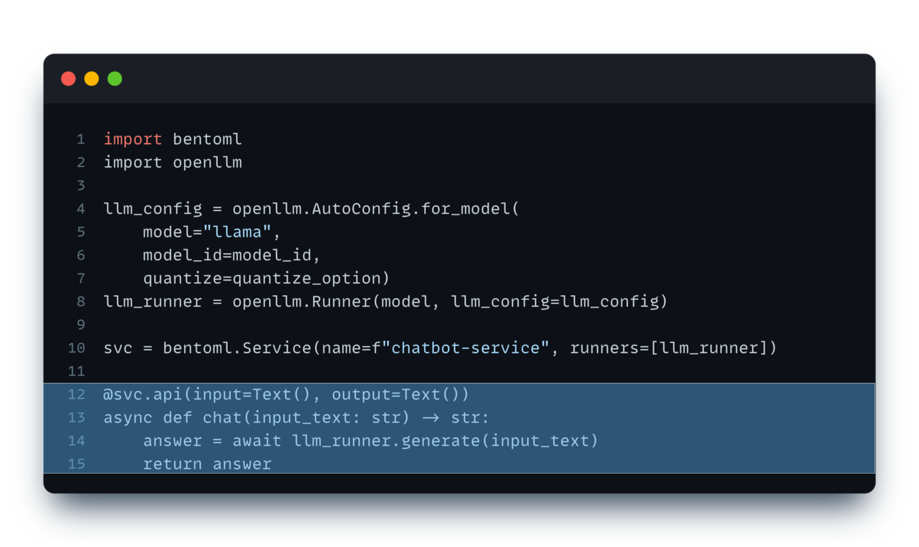
Bento Service

Slide 21
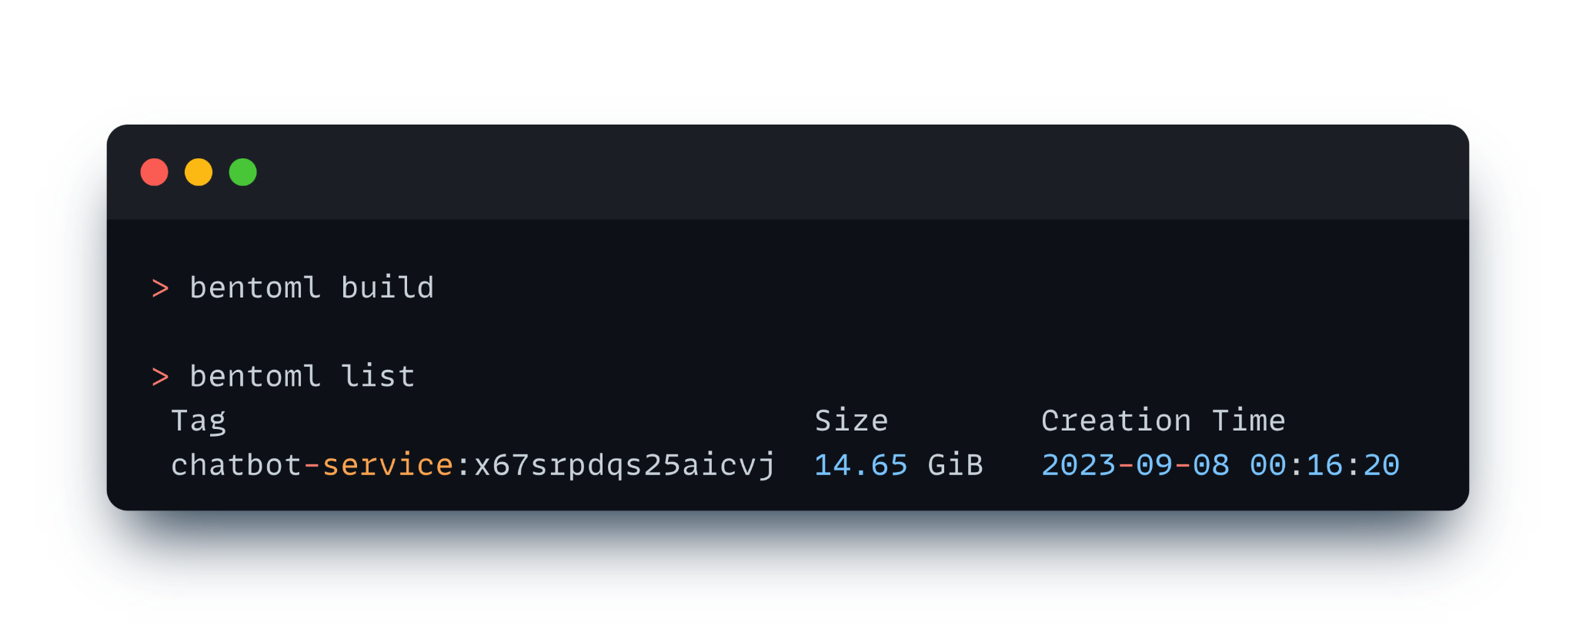
BentoML Build

Slide 22
Push to Remote on BentoCloud

Slide 23
OpenLLM
An open-source platform designed to facilitate the deployment and operation of LLMs in real-world applications.

Slide 24
OpenLLM: Deploy LLMs with A Single Command
Llama
ChatGLM
Dolly V2
Falcon
Flan-T5
CPT-NeoX
MPT
OPT
StableLM
StarCoder
Baichuan
Support all parameter sizes.
https://github.com/bentoml/openllm

Slide 25
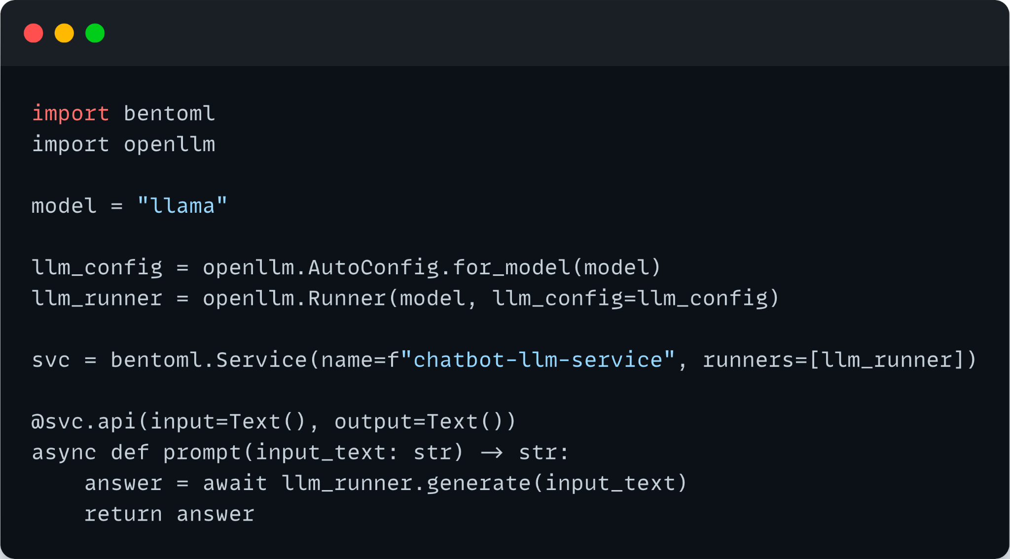
OpenLLM
Import as a Python library and start LLMs as a BentoML Runner

Slide 27
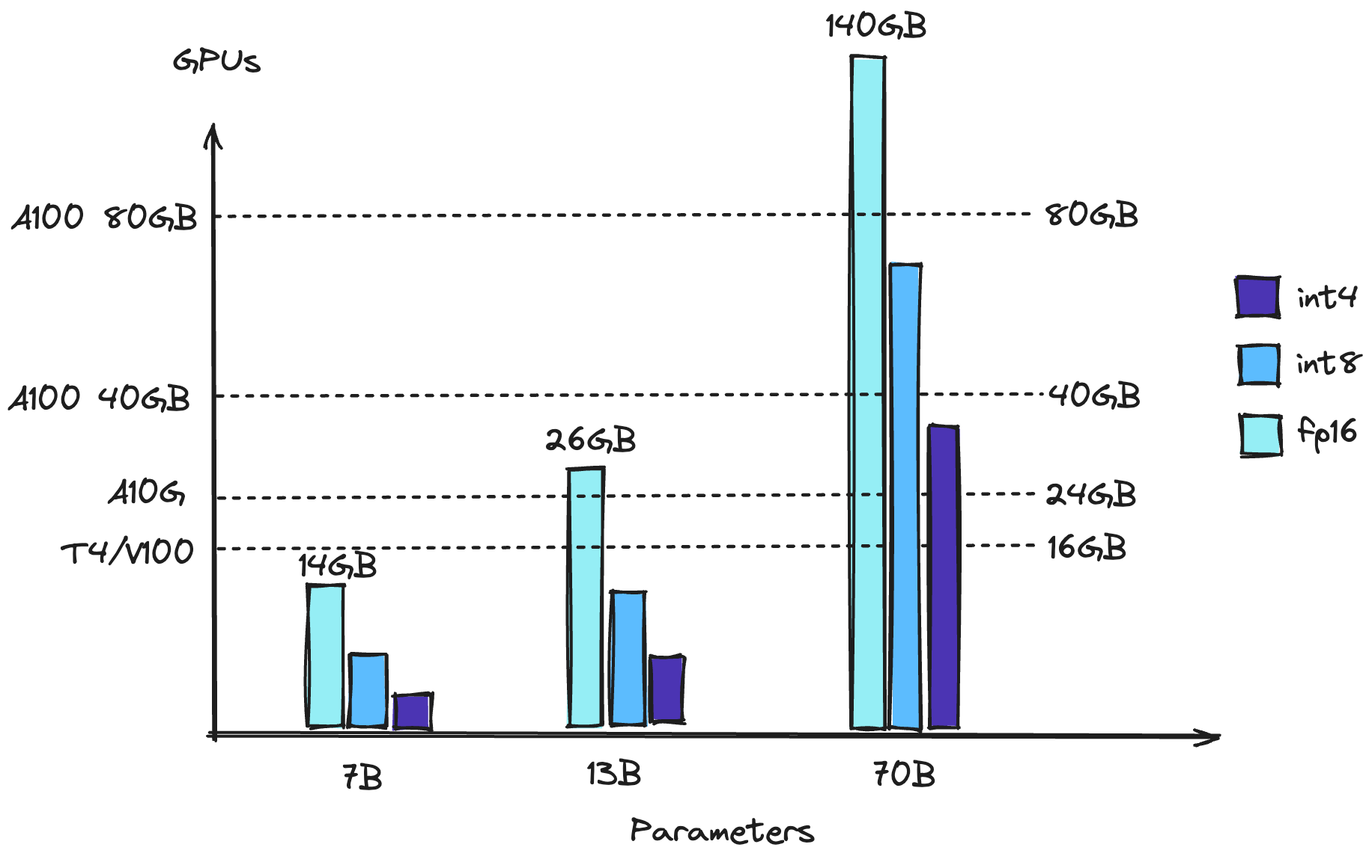
Quantization
Reduce GPU memory by running LLMs with lower precisions
Leave more memory for inference

Slide 28
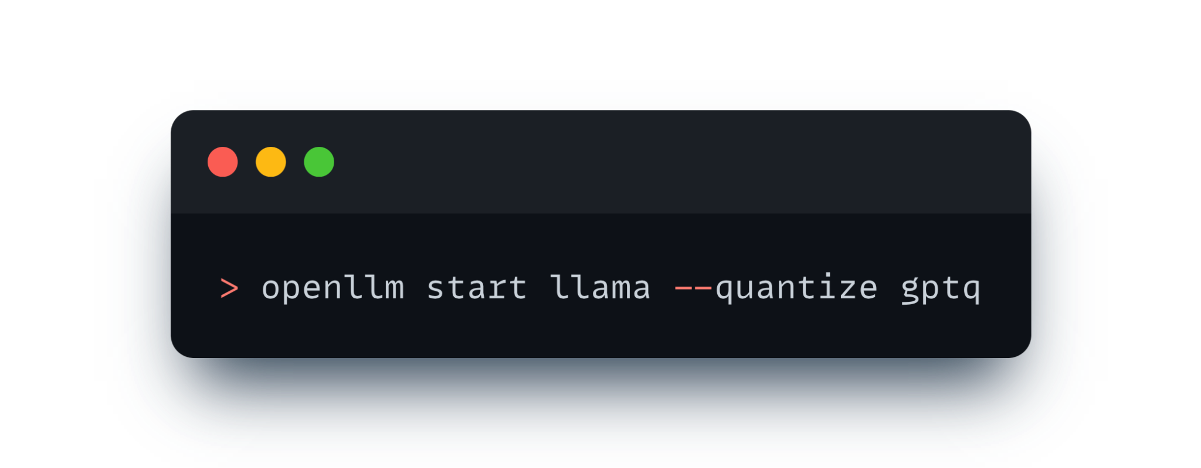
Quantization
Reduce GPU memory by running LLMs with lower precisions
Leave more memory for inference

Slide 29
Kernel Optimization
More efficient GPU instructions and memory allocation
LLM memory allocation is large and dynamic.
PagedAttention enables efficient use of GPU memory allocation
Allocate memory on-demand to achieve less wastage
Enables memory sharing

Slide 30
Continuous Batching vs. Static Batching
Completing four sequences using static batching. On the first iteration (left), each sequence generates one token (blue) from the prompt tokens (yellow). After several iterations (right), the completed sequences each have different sizes because each emits their end-of-sequence-token (red) at different iterations. Even though sequence 3 finished after two iterations, static batching means that the GPU will be underutilized until the last sequence in the batch finishes generation (in this example, sequence 2 after six iterations).
https://www.anyscale.com/blog/continuous-batching-llm-inference

Slide 31
Continuous Batching
Asynchronous schedule generation request as they arrive
Concurrent process pending requests in a dynamic batch
High concurrency thanks to PagedAttention’s efficient memory allocation
https://www.anyscale.com/blog/continuous-batching-llm-inference

Slide 32
Token Streaming
Return as soon as the tokens become ready
Improve perceived latency
Best for chat applications
Users can start consuming with generated contents without waiting for all tokens
Implemented as server-sent events on the /generate_stream endpoint

Slide 33
Token Streaming

Slide 34
Best Practices Baked-In
Fully customizable with Python
Integrate with Python ecosystem tools
Package models, source code, and configuration as 🍱 Bentos
Version control for 🍱 Bento and Models
Containerization into standard OCI compliant images
Complete observability with metrics, tracing, and logs
Inference workload environment
Real-time Inference
Batch Inference
Flexible deployment

Slide 35
THANK YOU
QUESTIONS?
Join the BentoML Slack community: https://l.bentoml.com/join-slack
欢迎扫码打卡
积分可兑换对应礼品哟！
扫码添加讲师联系方式

